Slide 1
Oracle ML Demo
Barry Starkey Northgate Public Services.

Slide 2
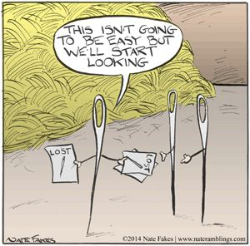
Next months rent
Imagine you are a large social landlord and you manage 30,000 rented properties.
Resources are tight, where do you direct your teams?
Calling all your tenants each week to encourage them isn’t an option.
Where will your efforts do the most good and help the most people?

Slide 3
Machine learning
Oracle ML can be accessed on premise via SQL Developer Data Miner GUI.
It’s point and click interface needs no real knowledge of the underlying SQL.
Moving to the Oracle Cloud we need that understanding.

Slide 4
Lets get started
Oracle Cloud ML Zeppelin Notebooks have a very good example section to help you.
However, today were going to use the established, easy to use GUI in SQL Developer
and Data Miner to get us started.

Slide 6
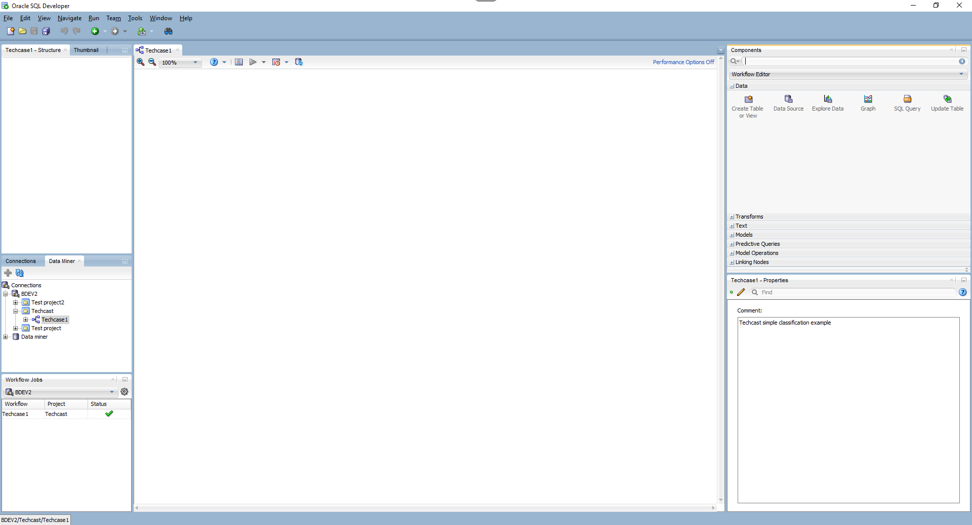

Slide 7
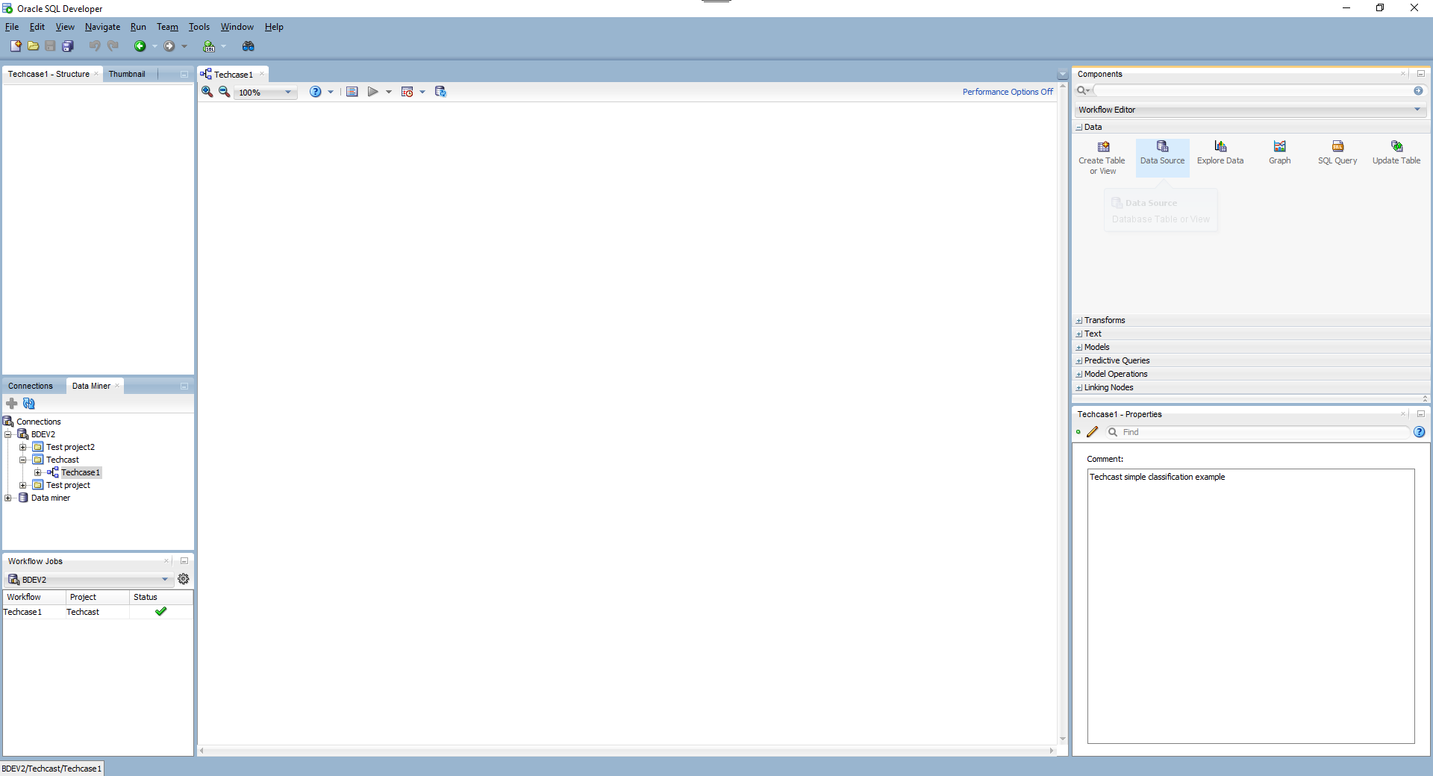

Slide 8
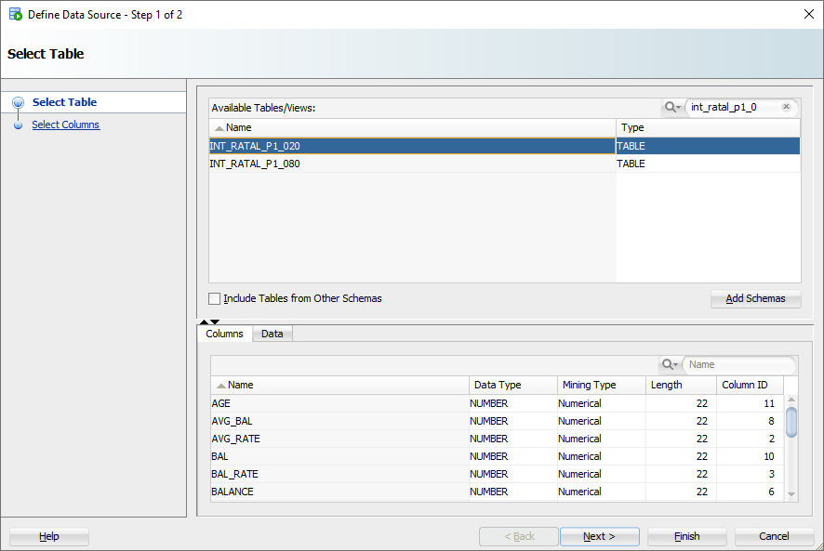

Slide 9
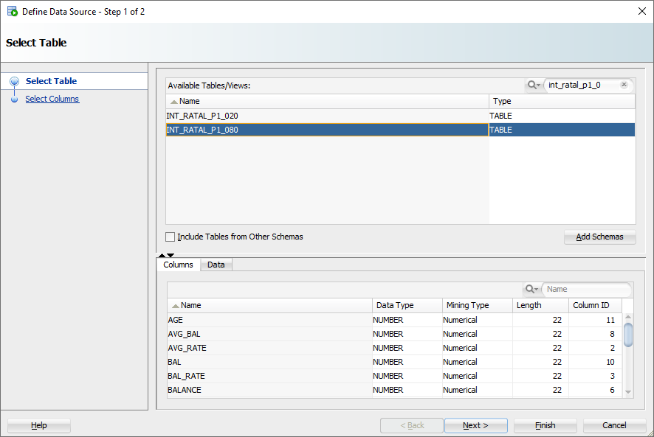

Slide 10
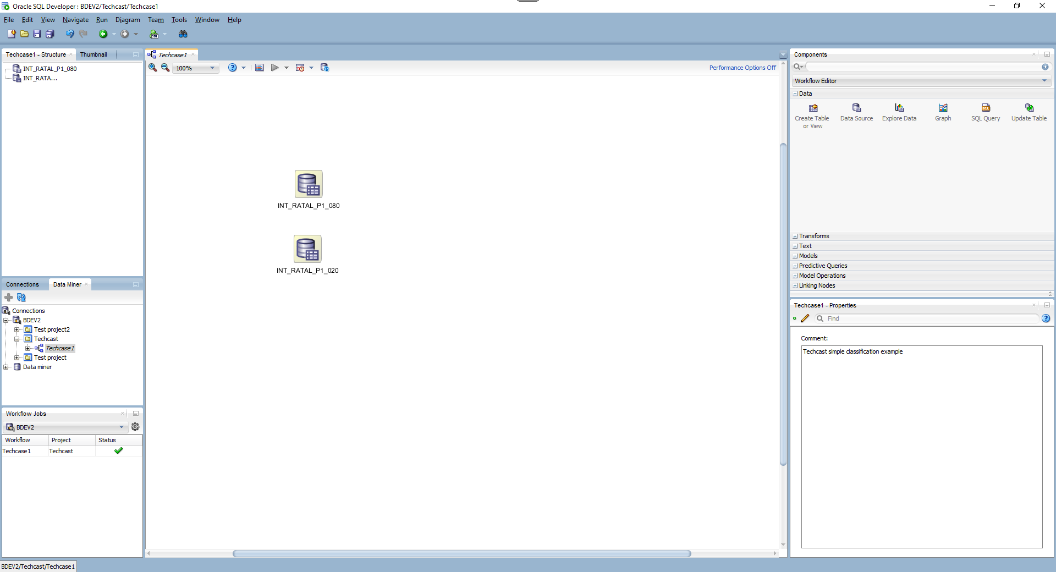

Slide 11
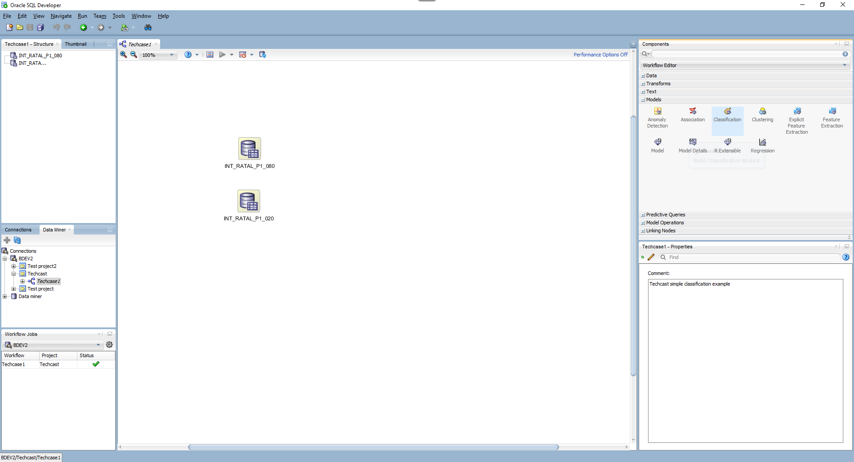

Slide 12
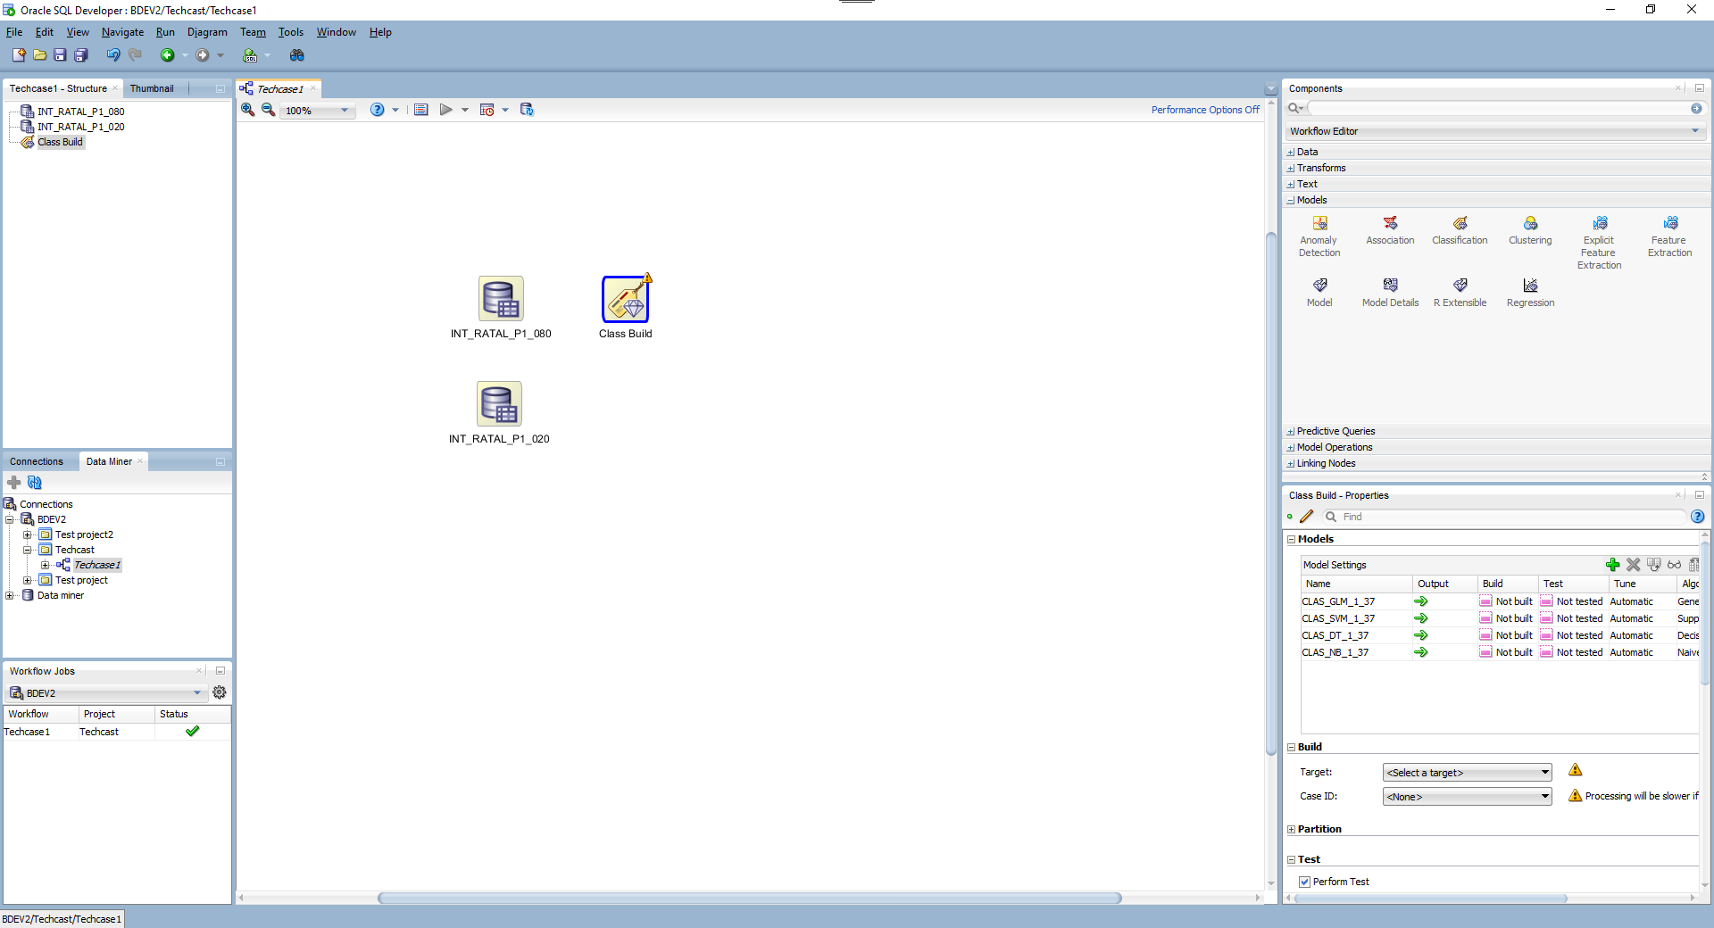

Slide 13
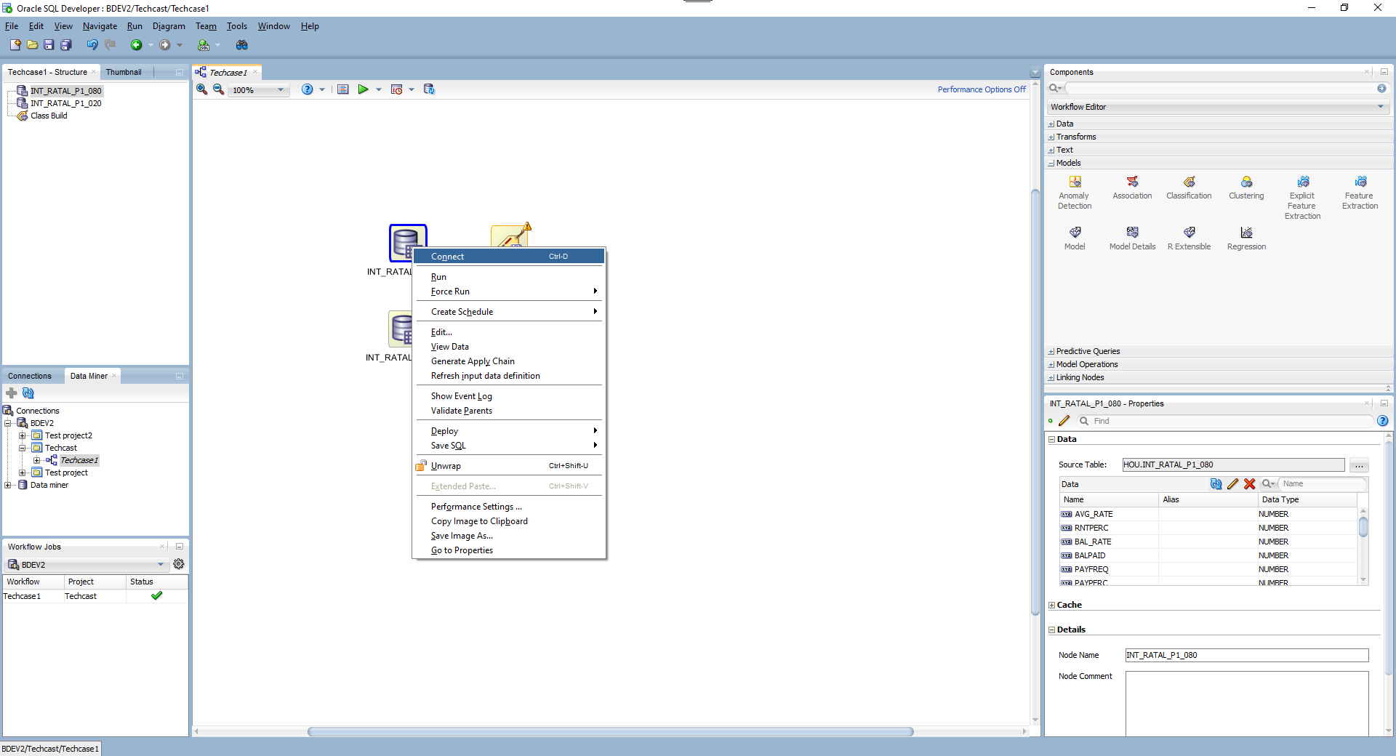

Slide 14
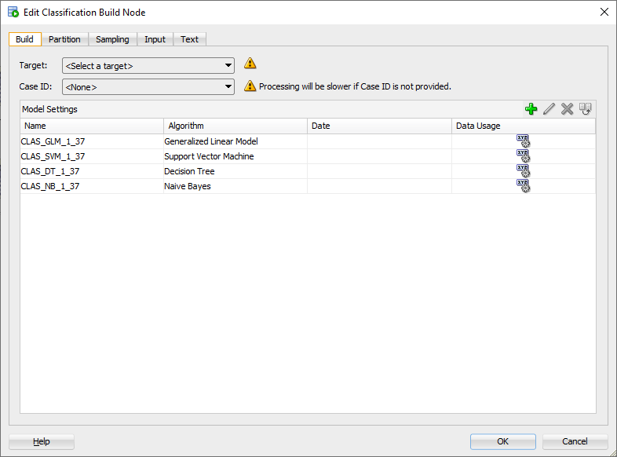

Slide 15
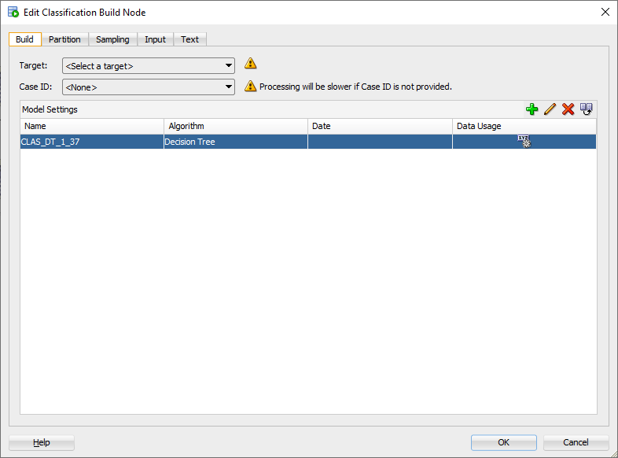

Slide 16
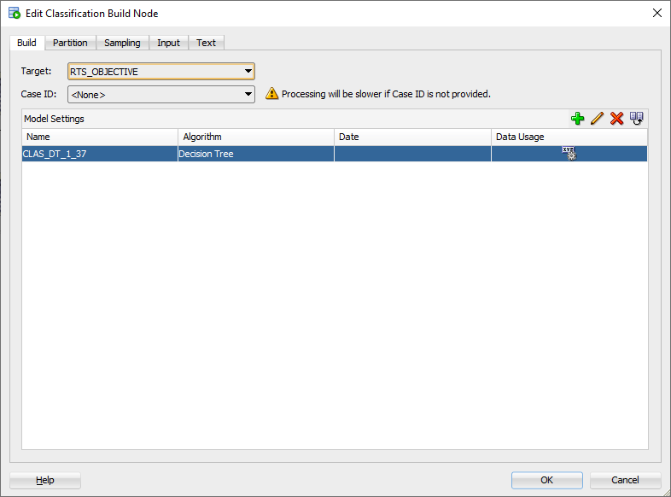

Slide 17
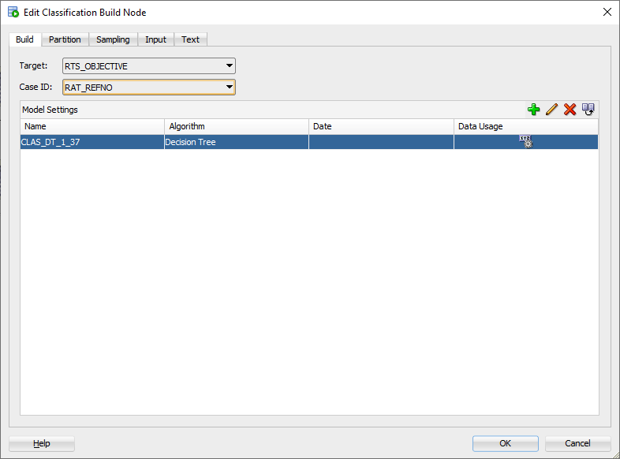

Slide 18
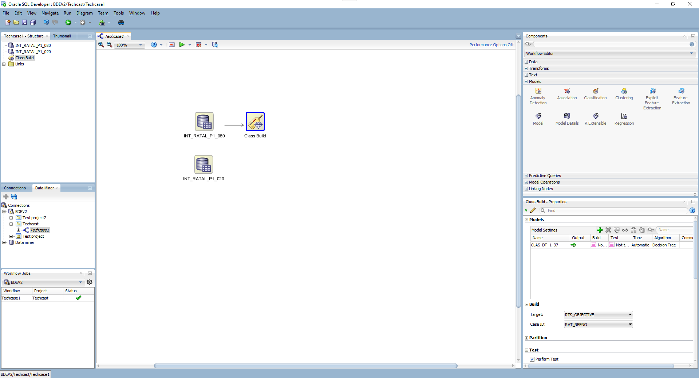

Slide 20
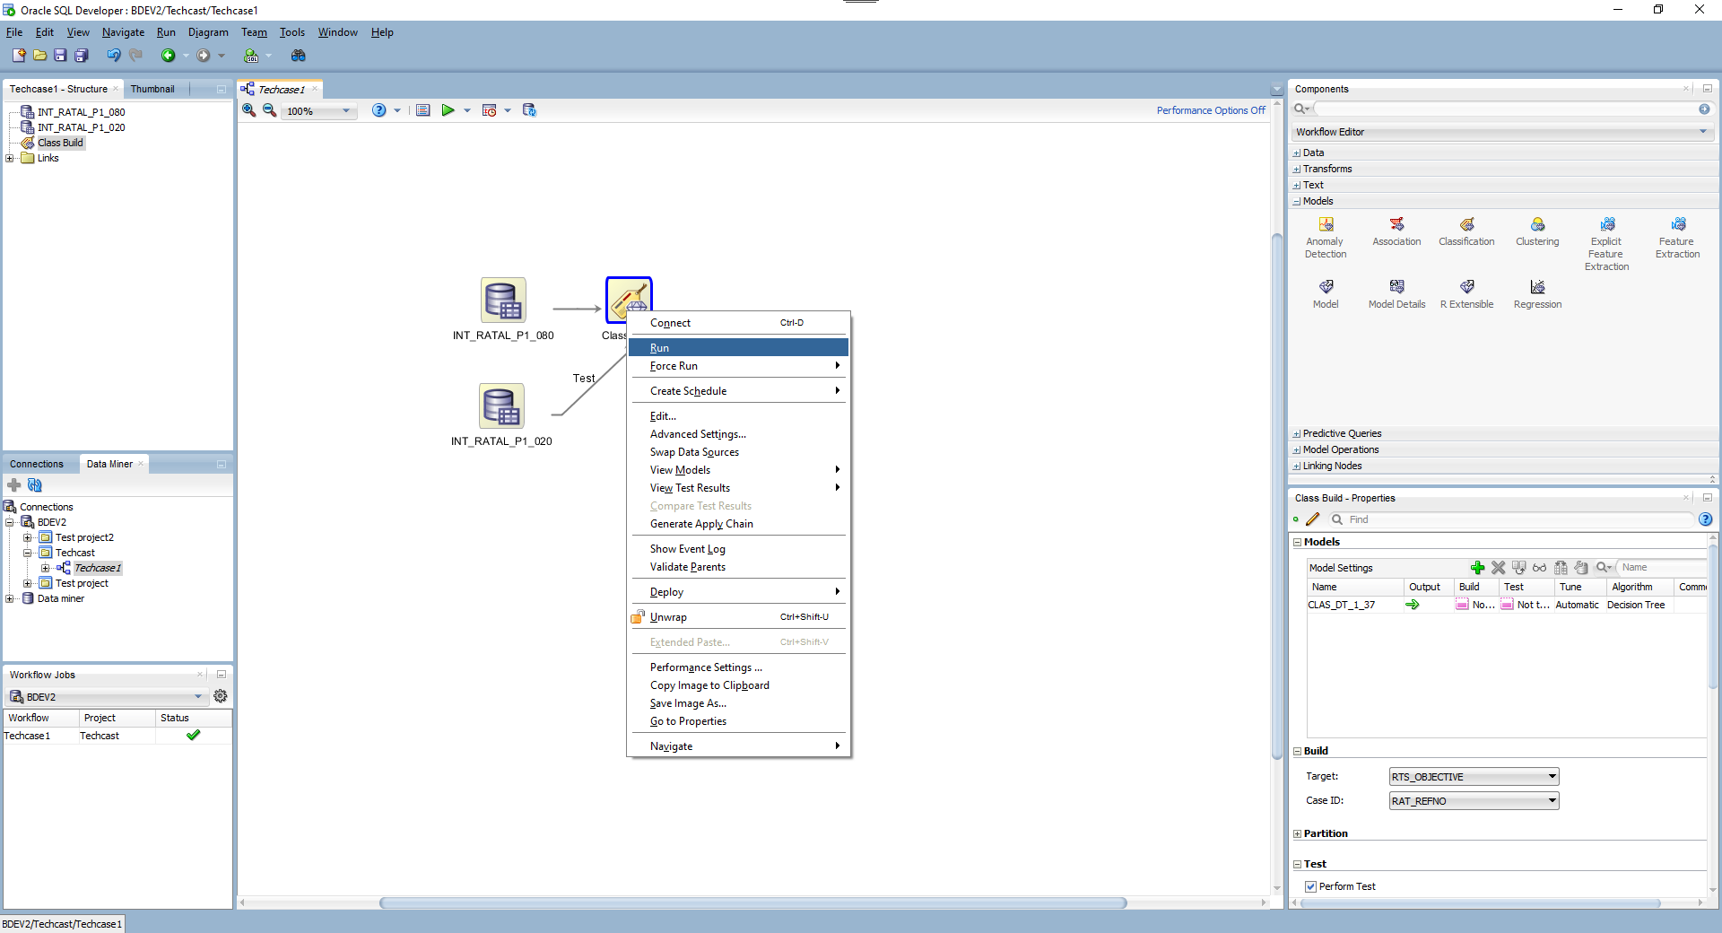

Slide 21
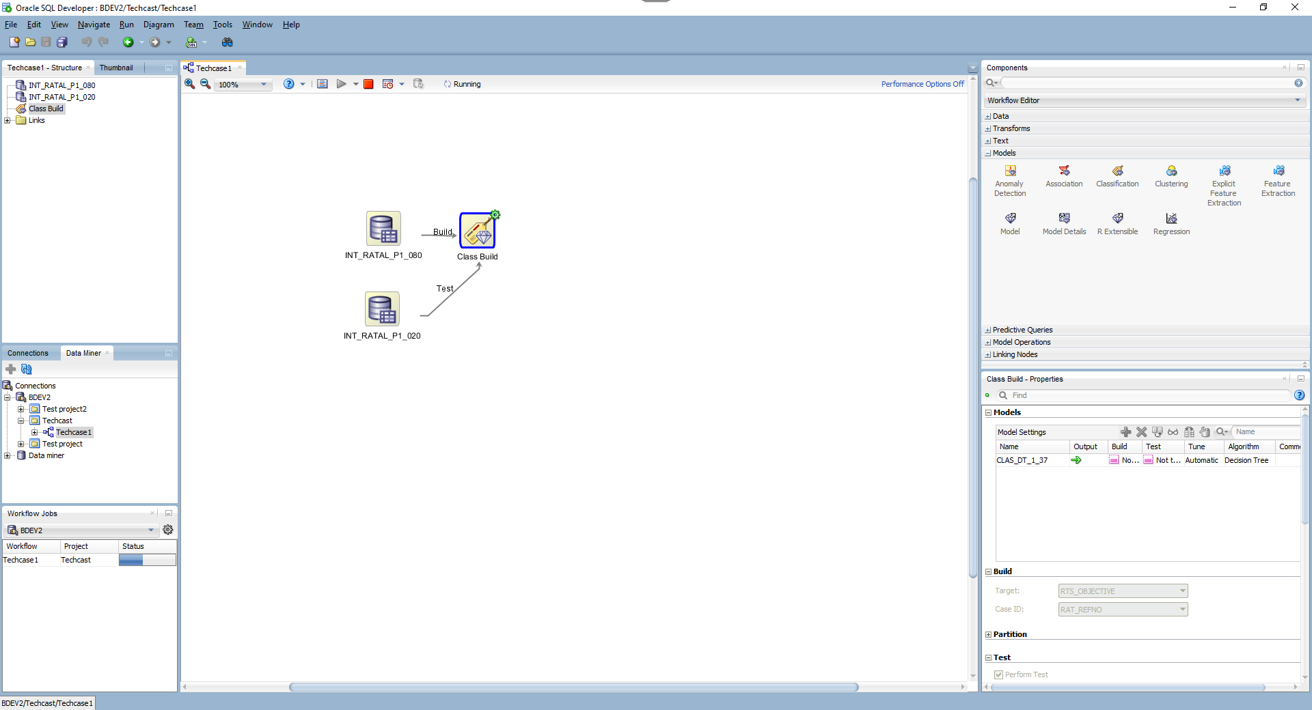

Slide 24
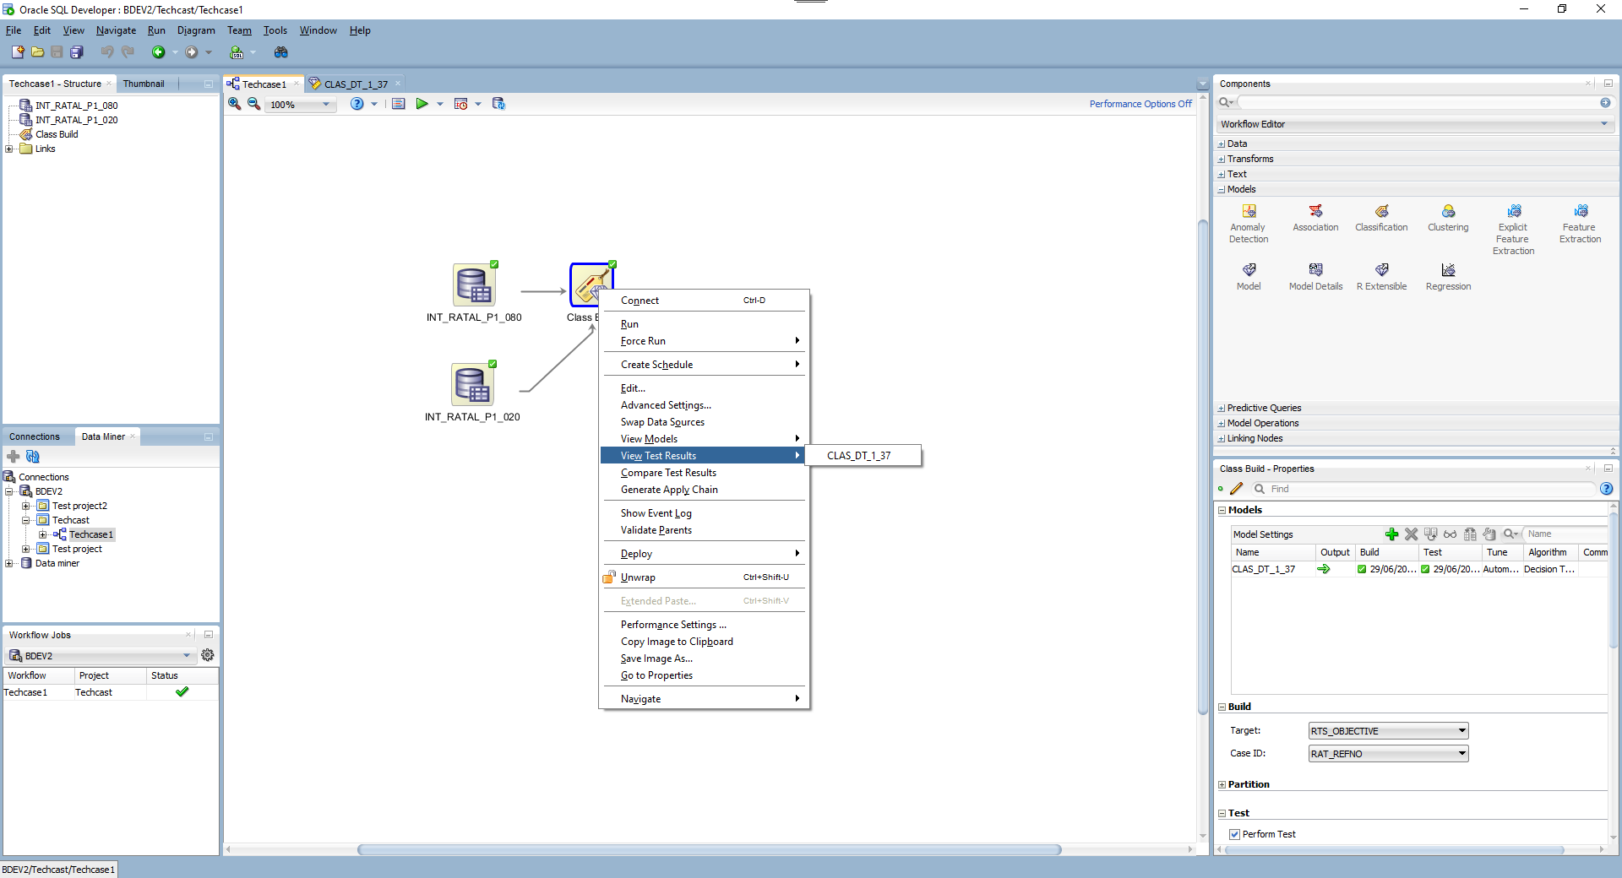

Slide 25
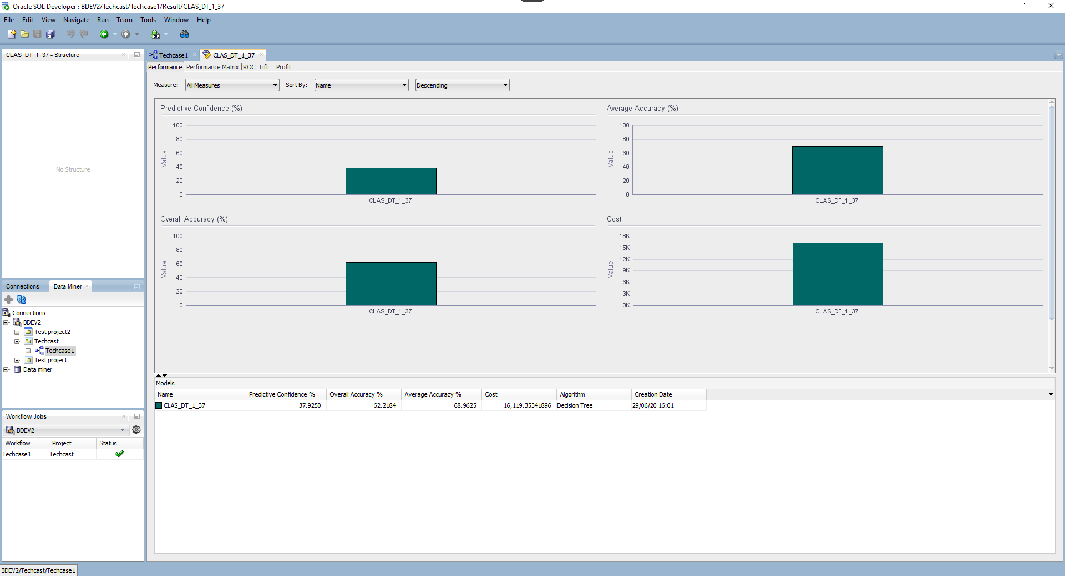

Slide 26
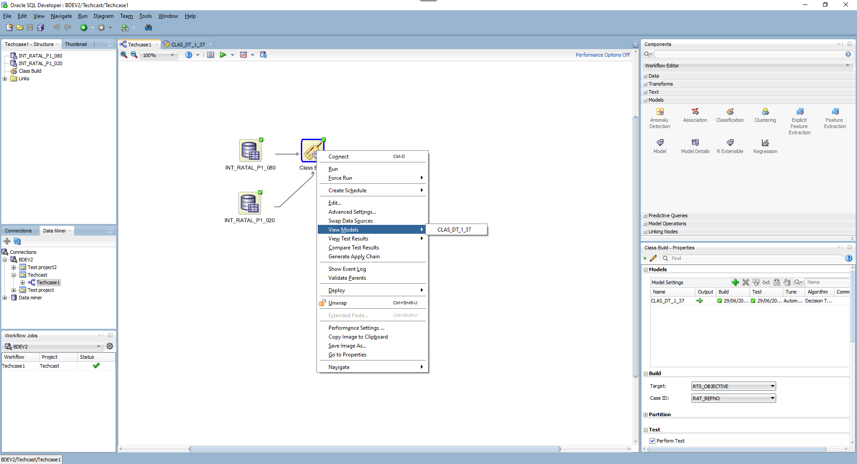

Slide 27
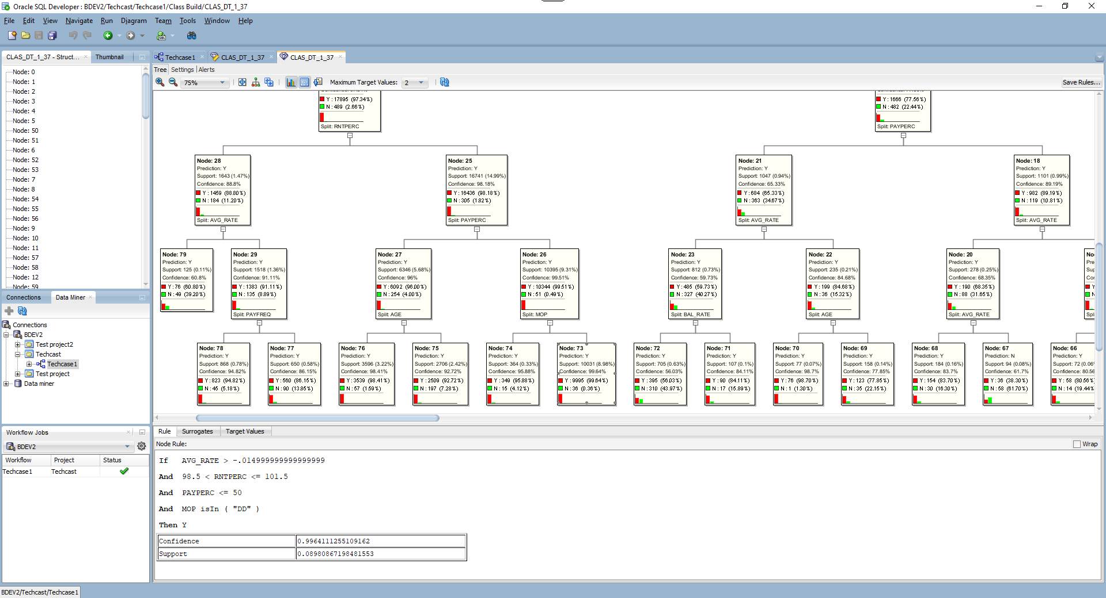

Slide 28
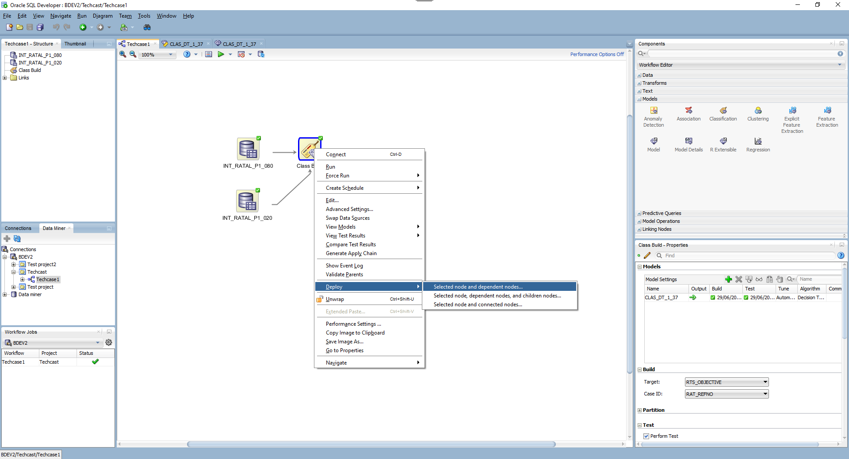

Slide 29
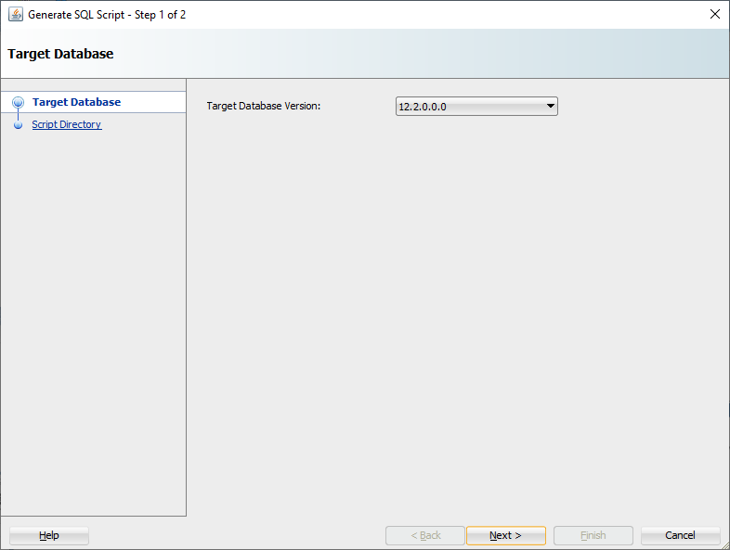

Slide 30
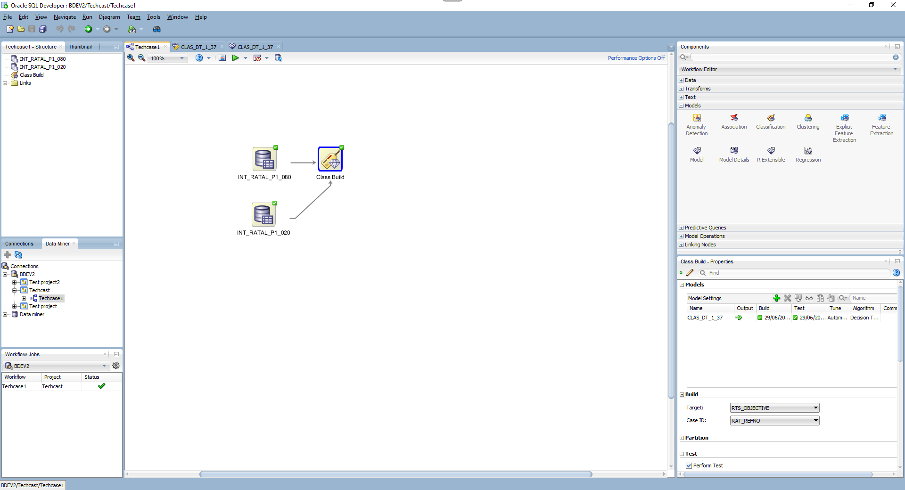

Slide 32
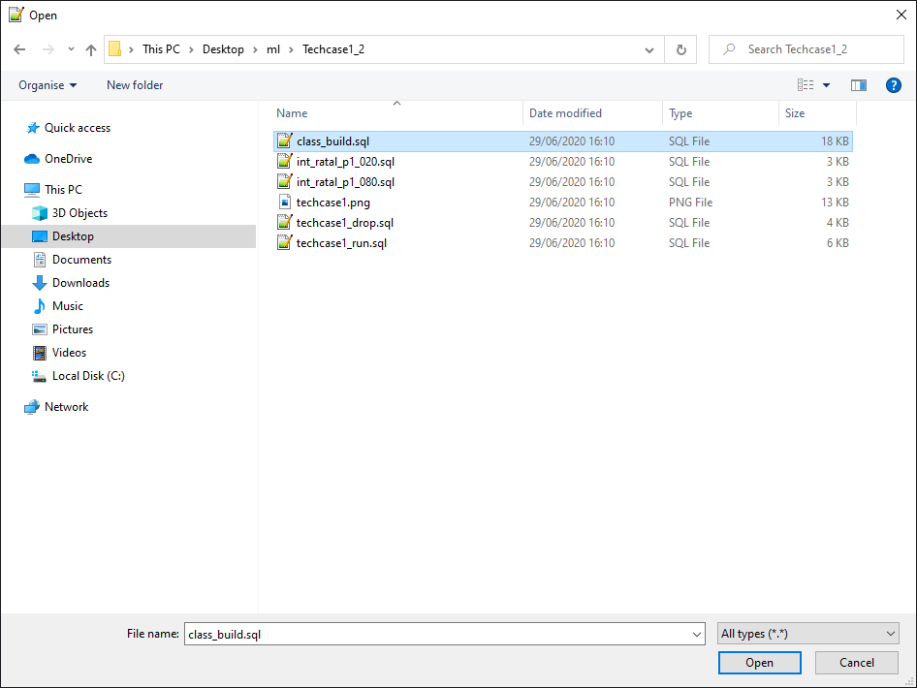

Slide 33
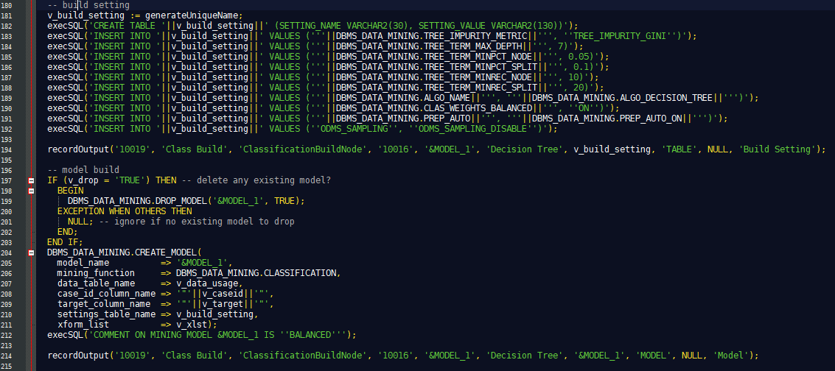

Slide 34
Now into the Cloud
Now the same model in Oracle Autonomous Data Warehouse Zeppelin Notebook.
ADW is like test driving a Tesla. You never want to go back!

Slide 35
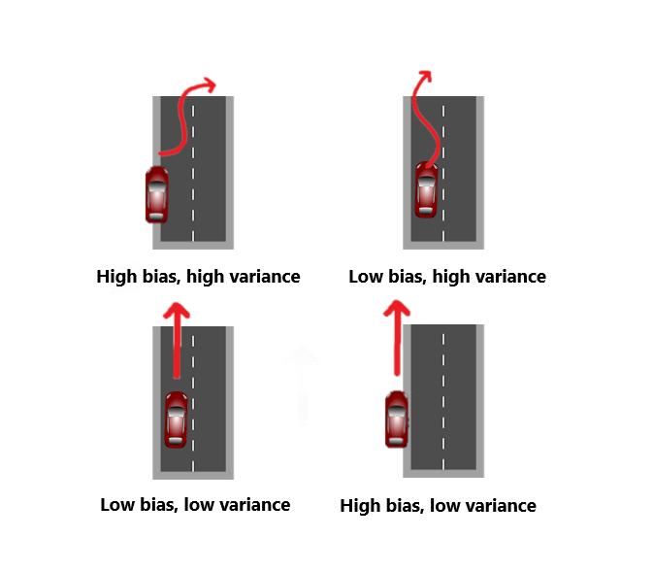
Bias versus variance
The model were going to build is based on 3.1 million training data set
91% of these will pay their rent in the coming month
We want to find the needles in the haystack that aren’t going to pay

Slide 36
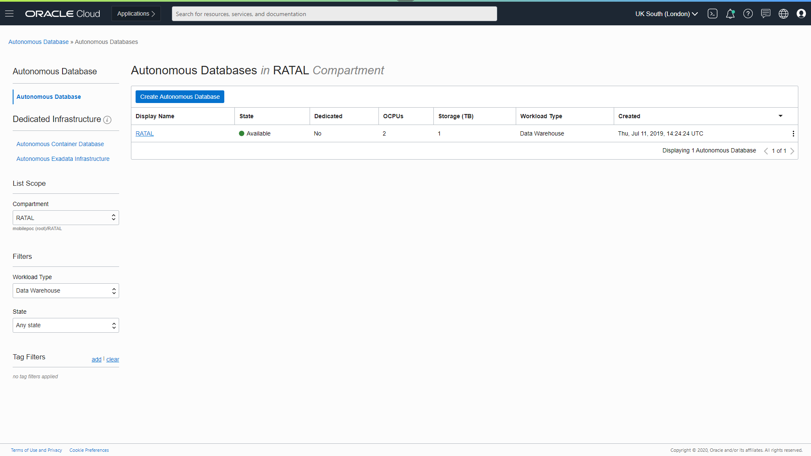

Slide 37
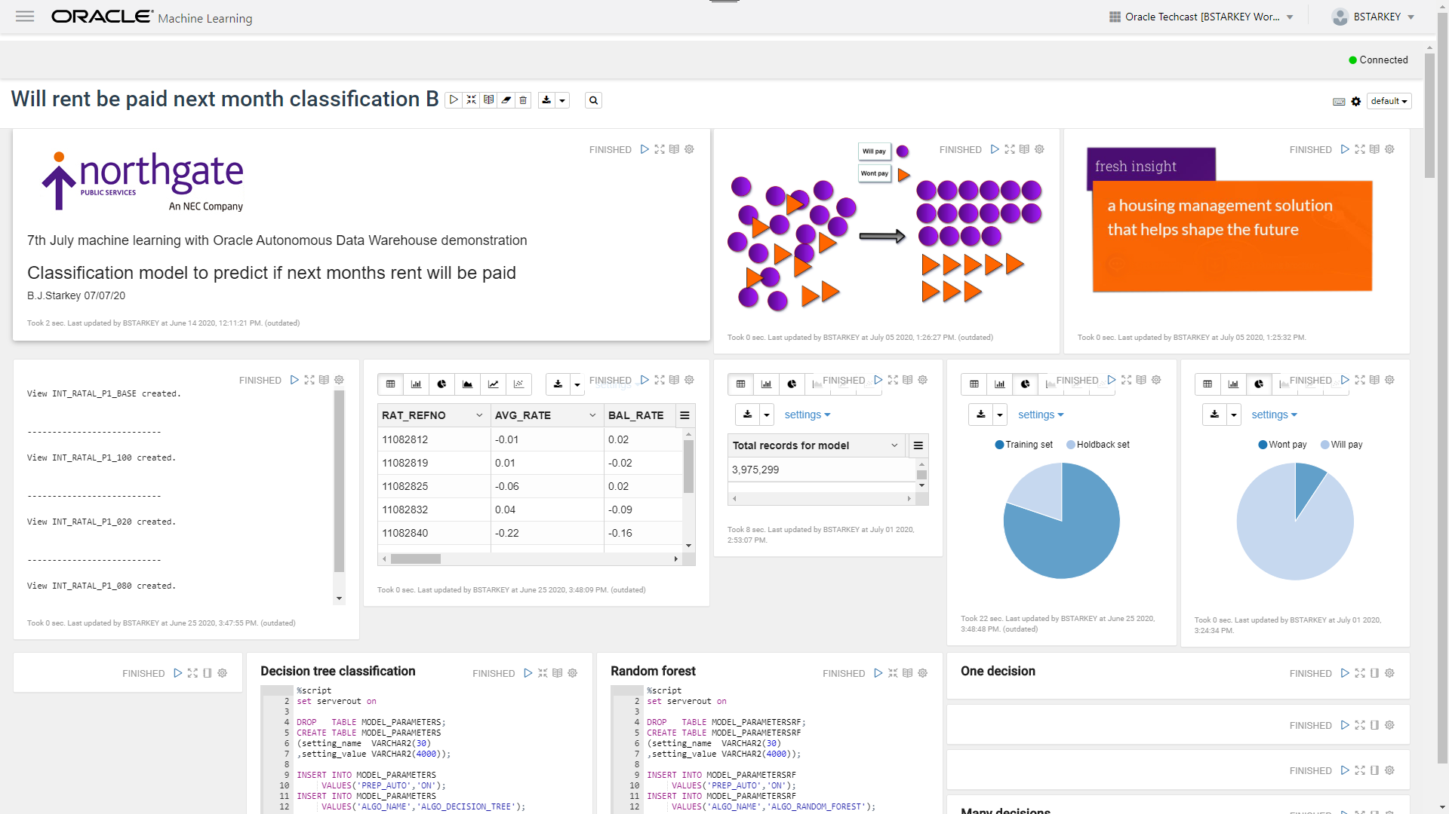

Slide 38
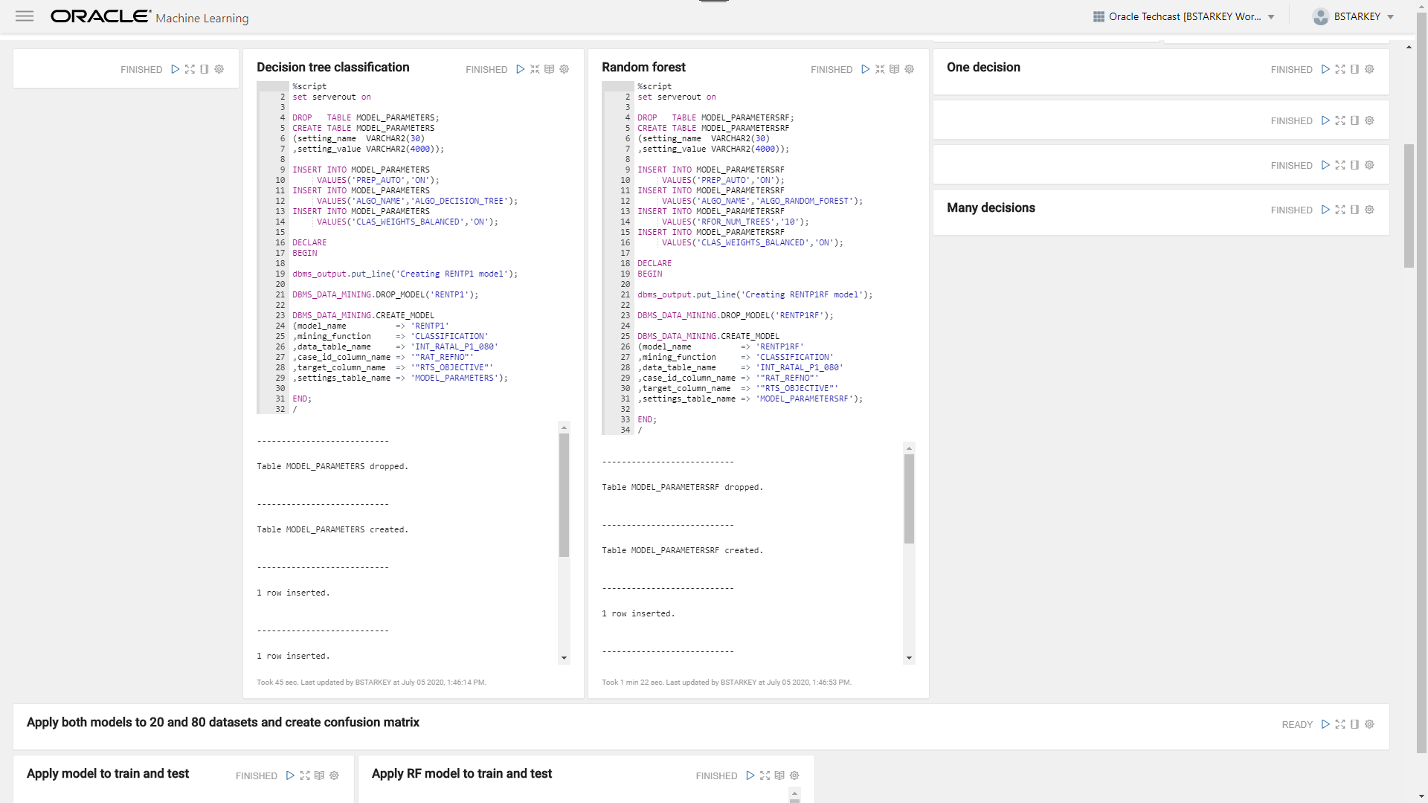

Slide 39
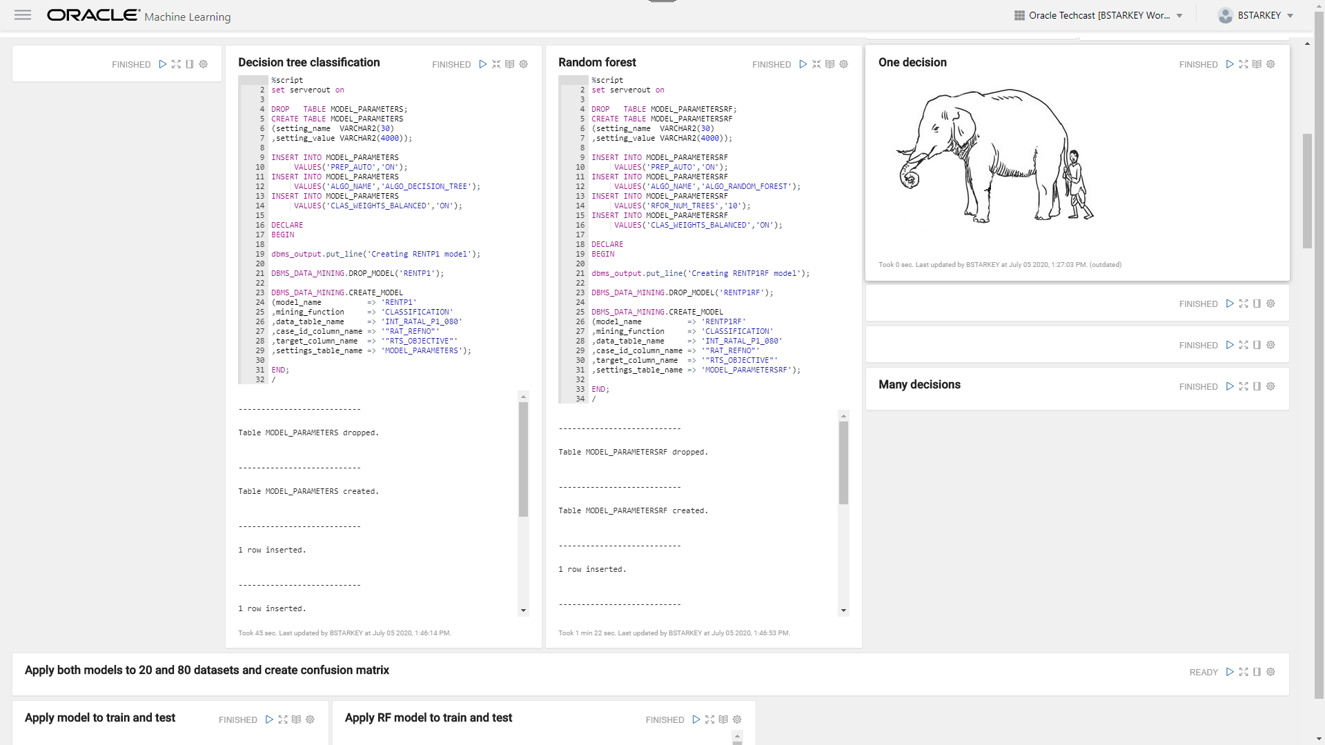

Slide 40
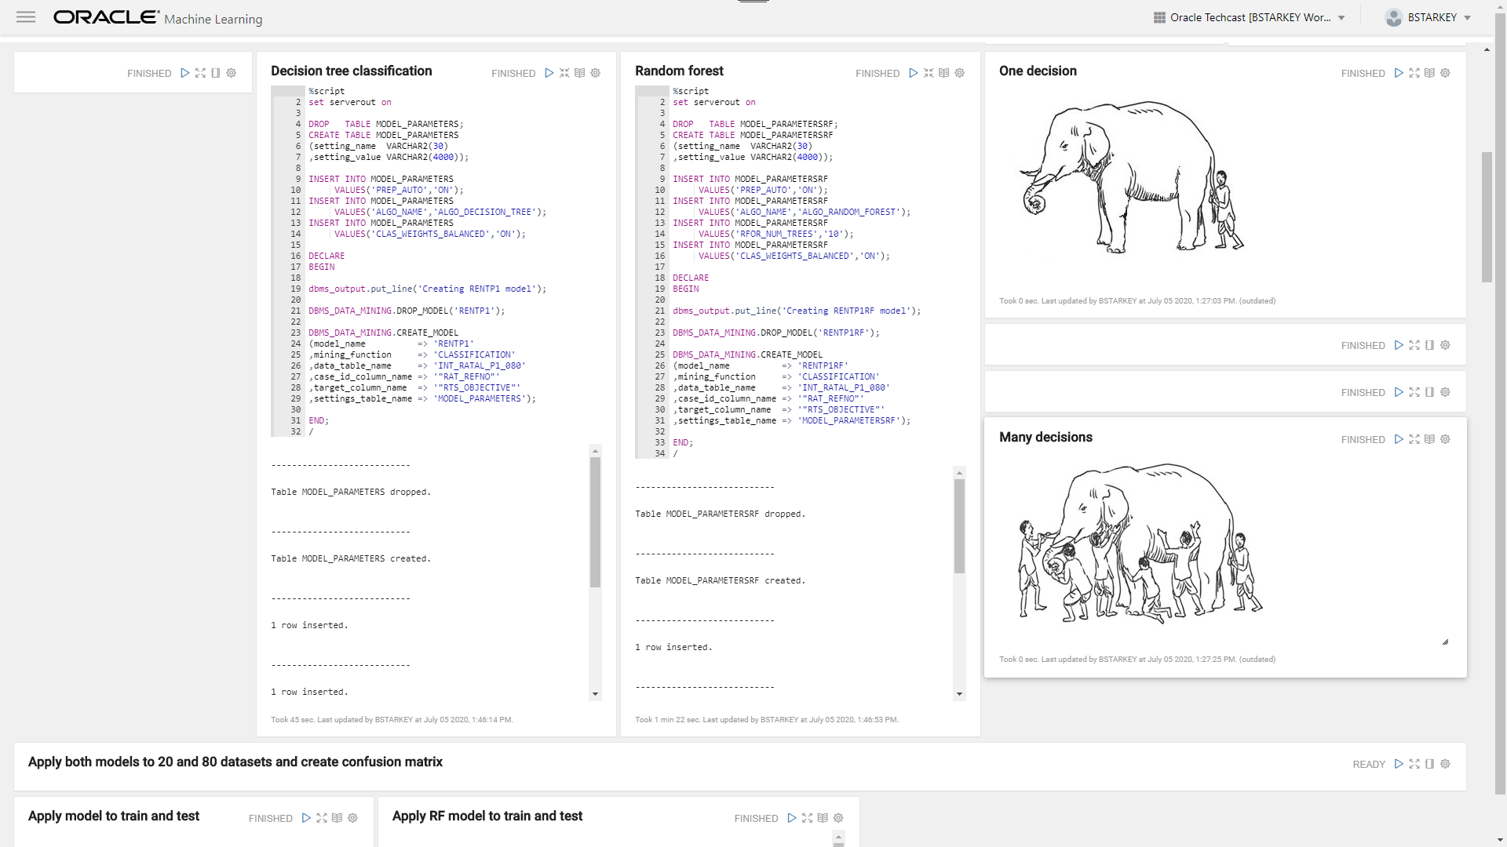

Slide 41
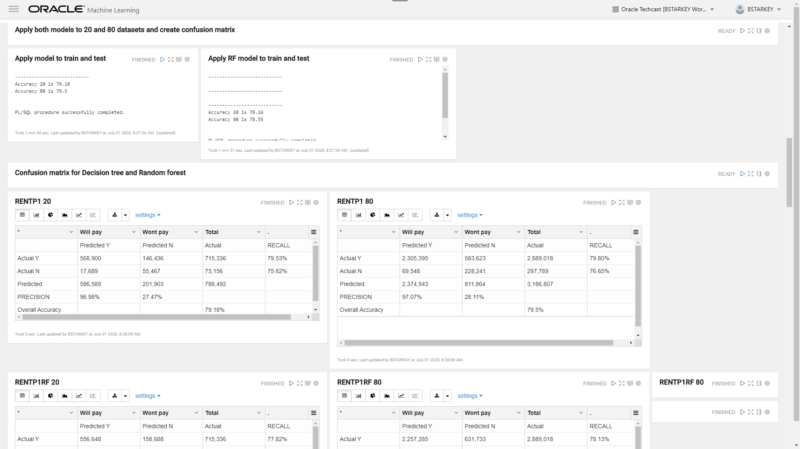

Slide 42
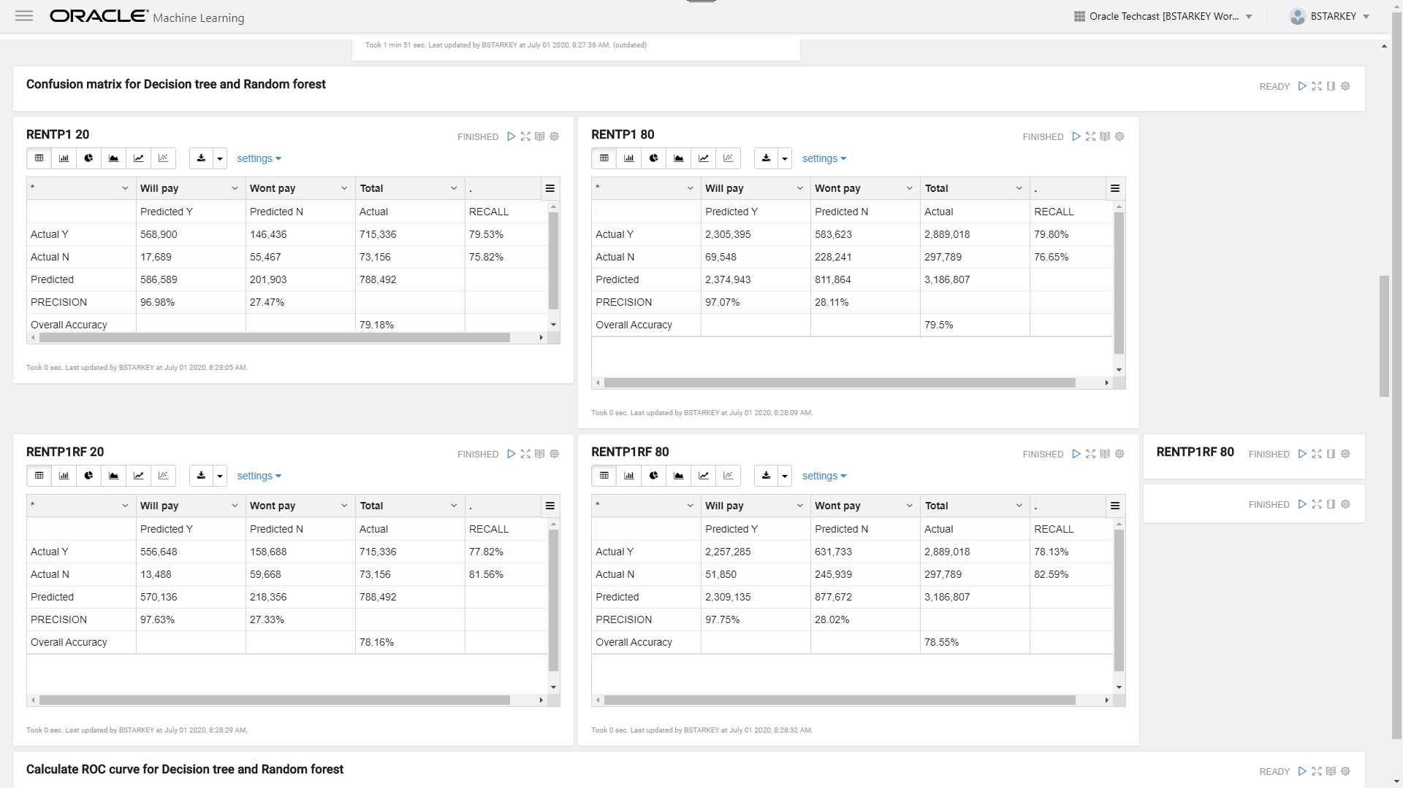

Slide 43
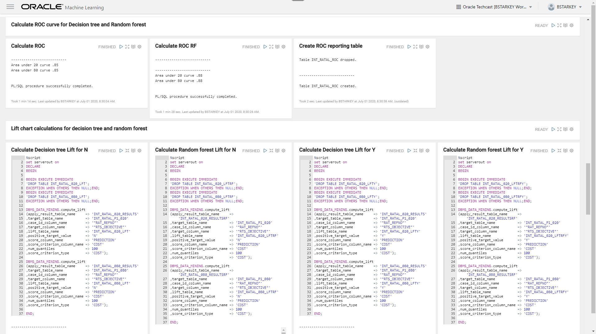

Slide 44
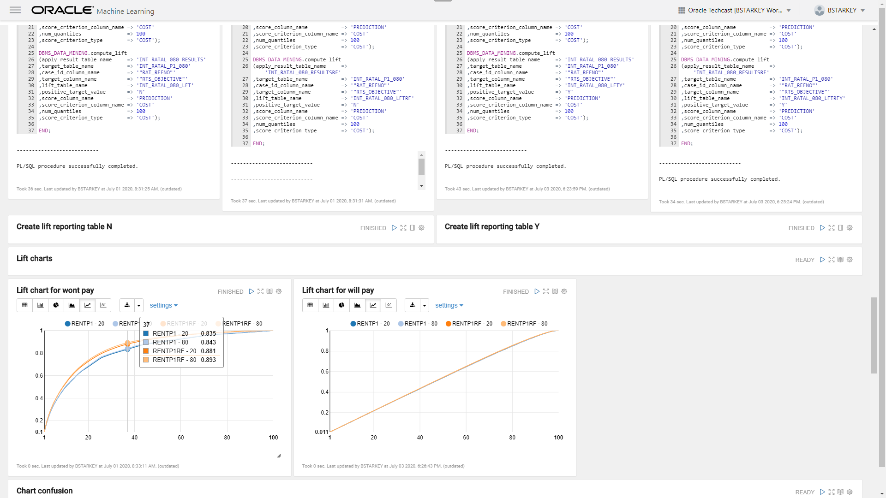

Slide 45
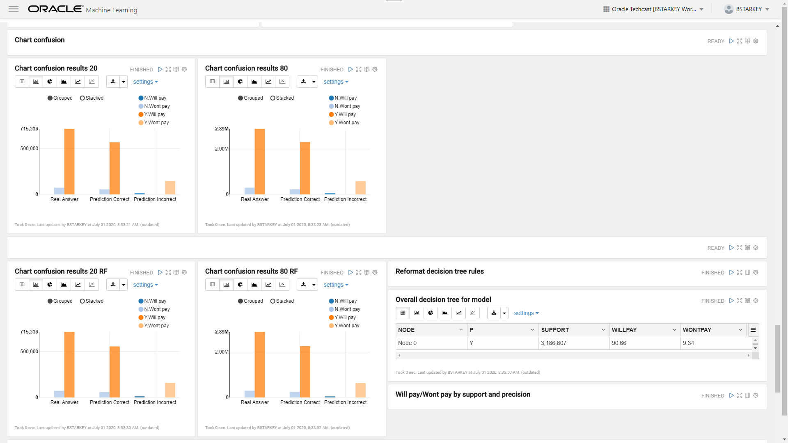

Slide 46
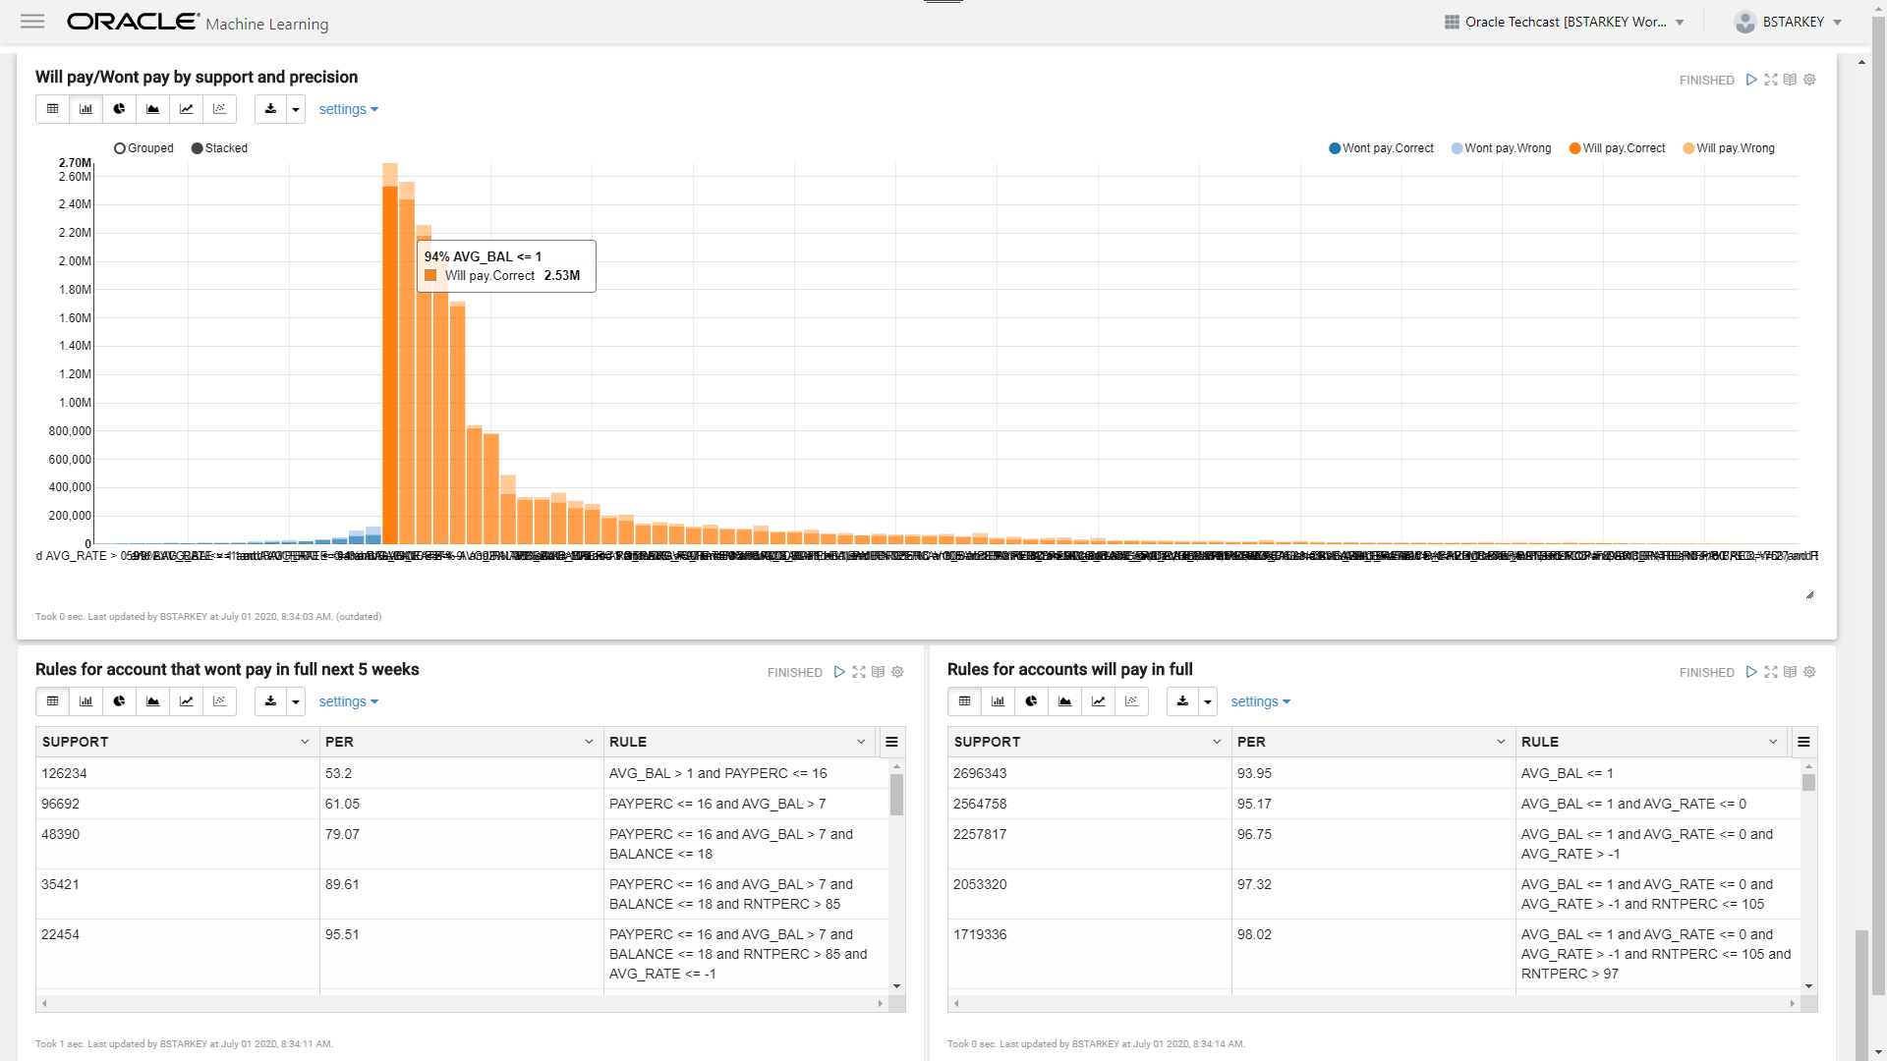

Slide 47
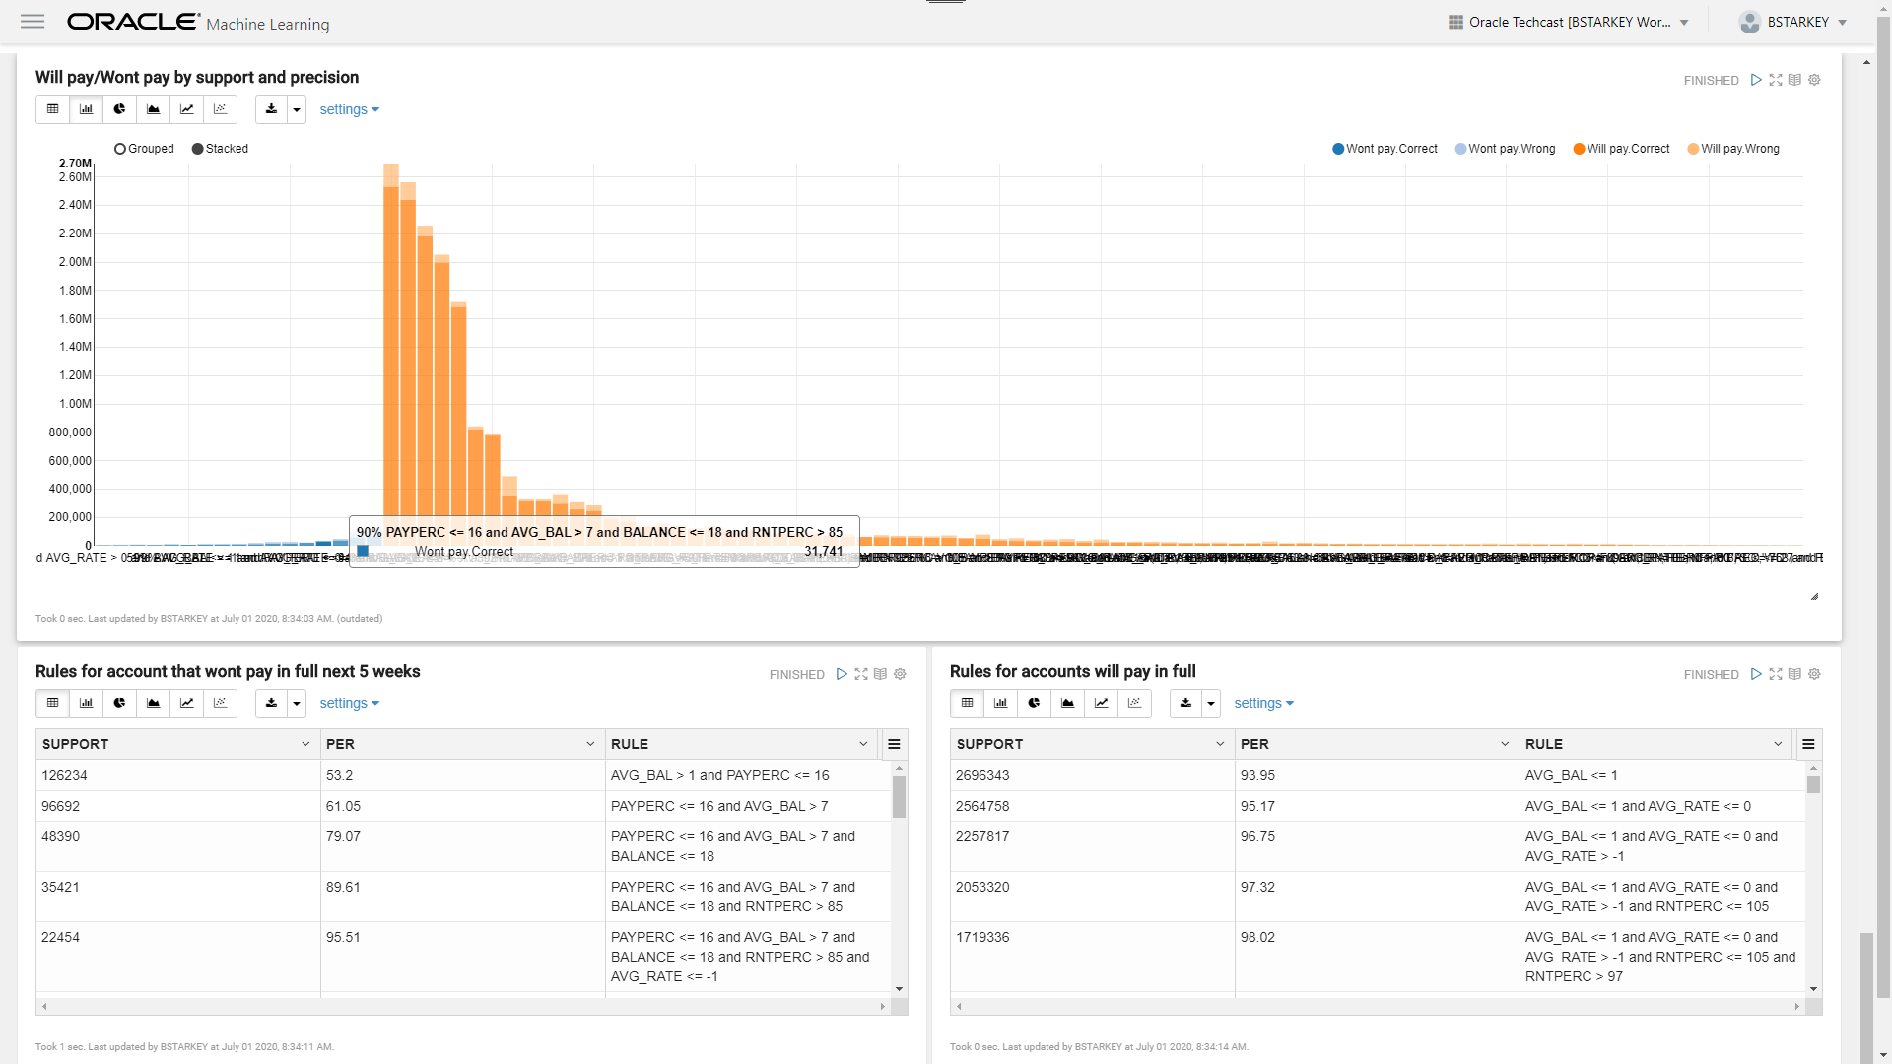

Slide 48
Lets Visualise
Now were going to investigate our models in Oracle Analytic Cloud
OAC is like “Autopilot” for your data
“The greatest value of a picture is when it forces us to notice what we never expected to see.”
John Tukey

Slide 49
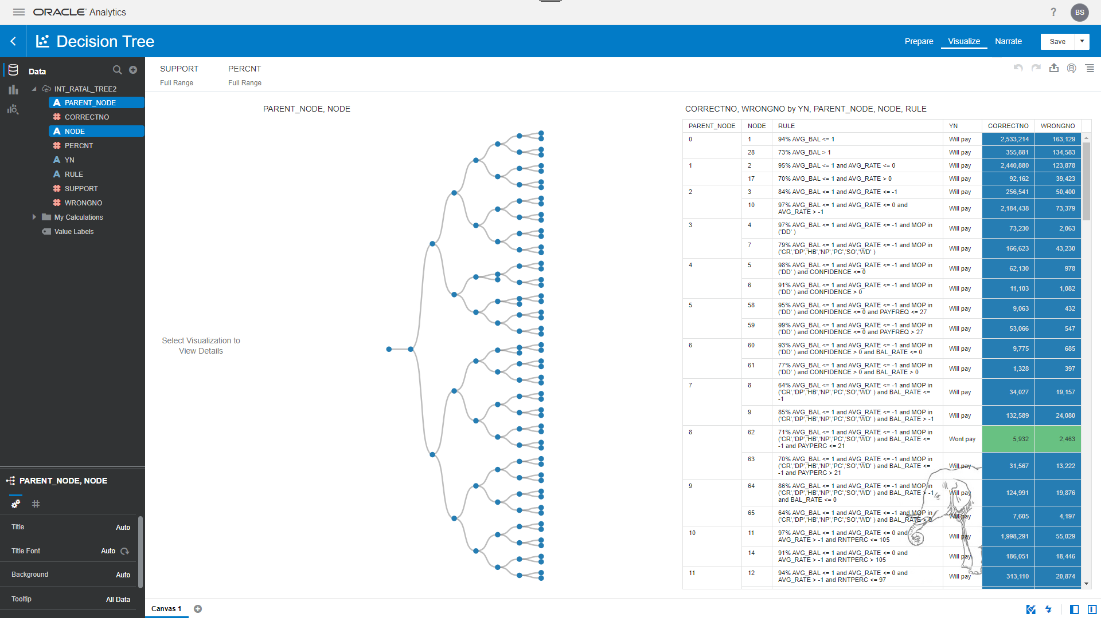

Slide 50
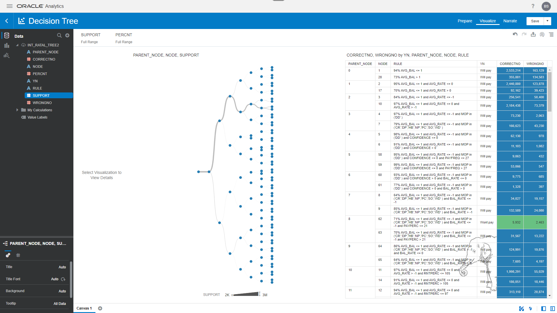

Slide 51
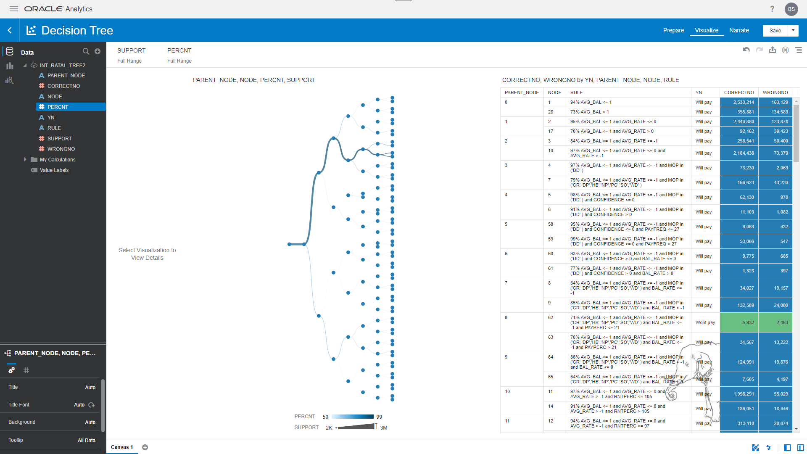

Slide 53
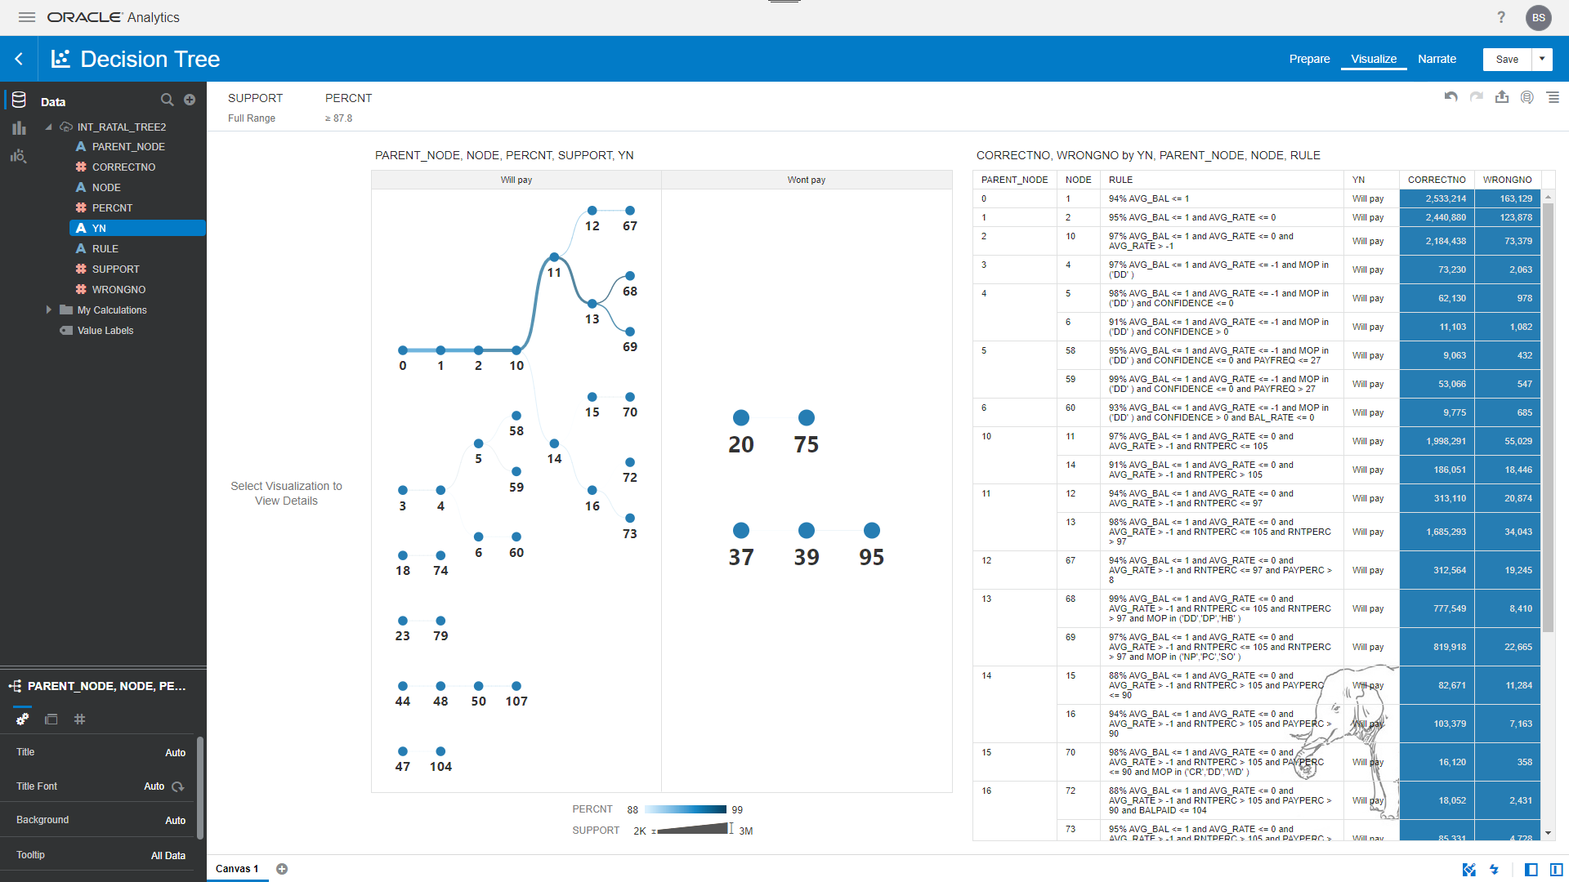

Slide 54
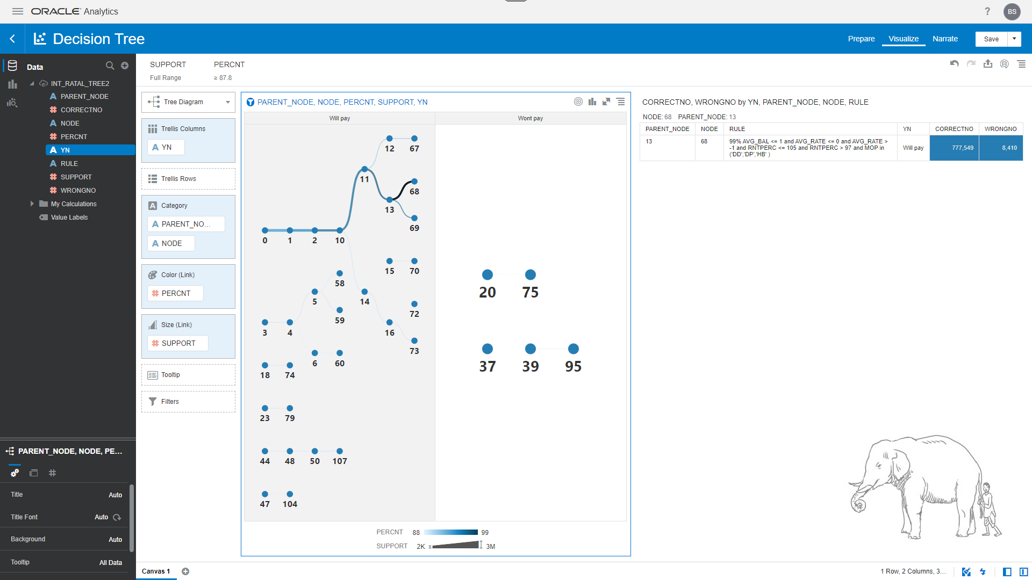

Slide 55
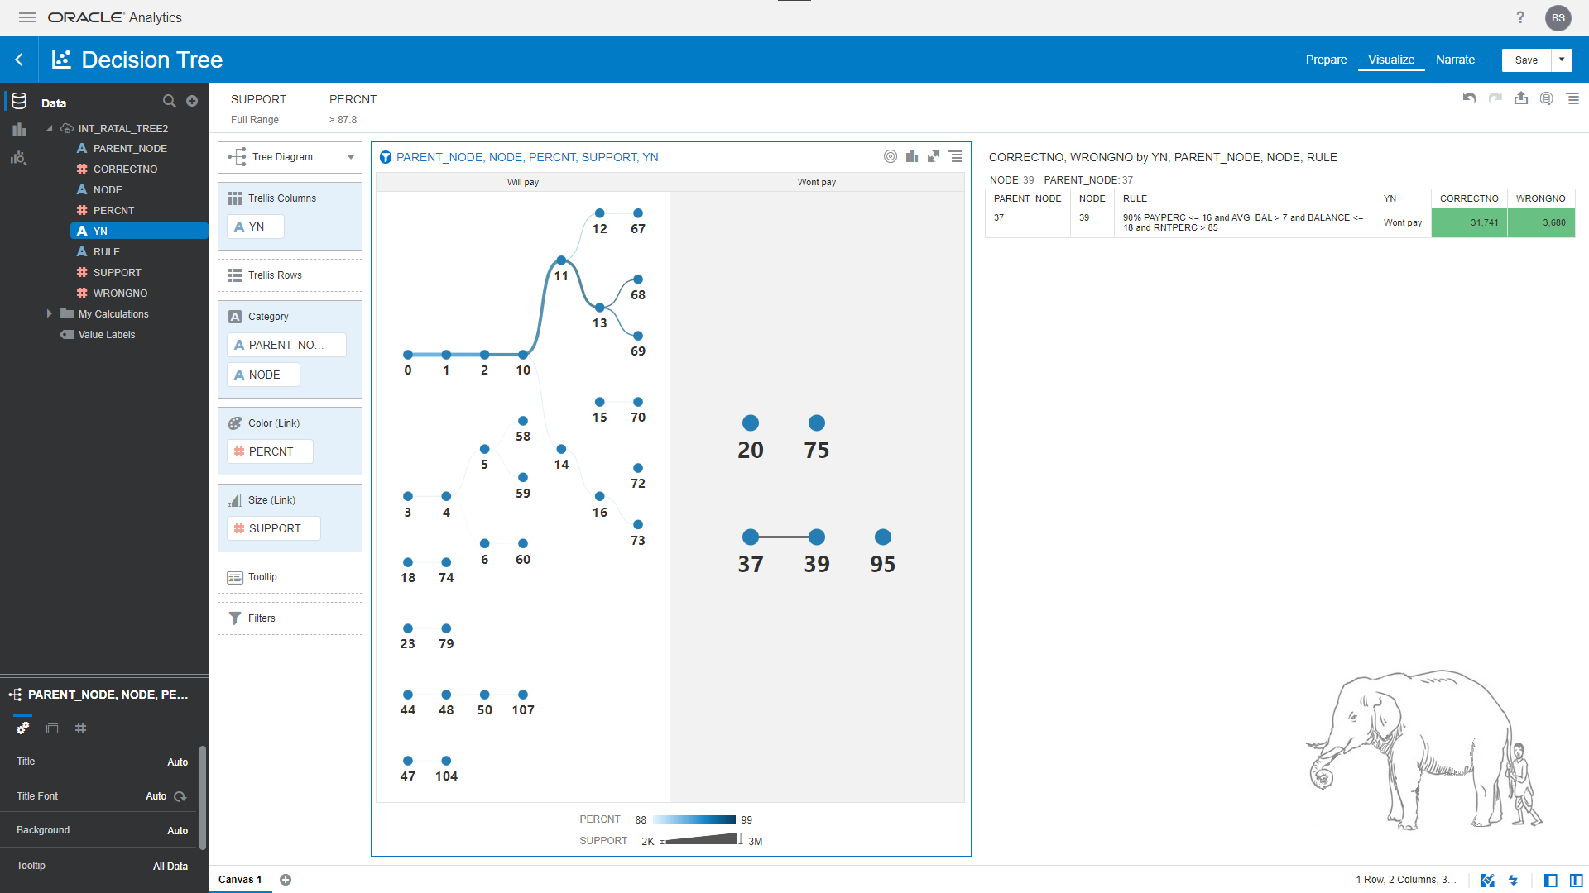

Slide 56
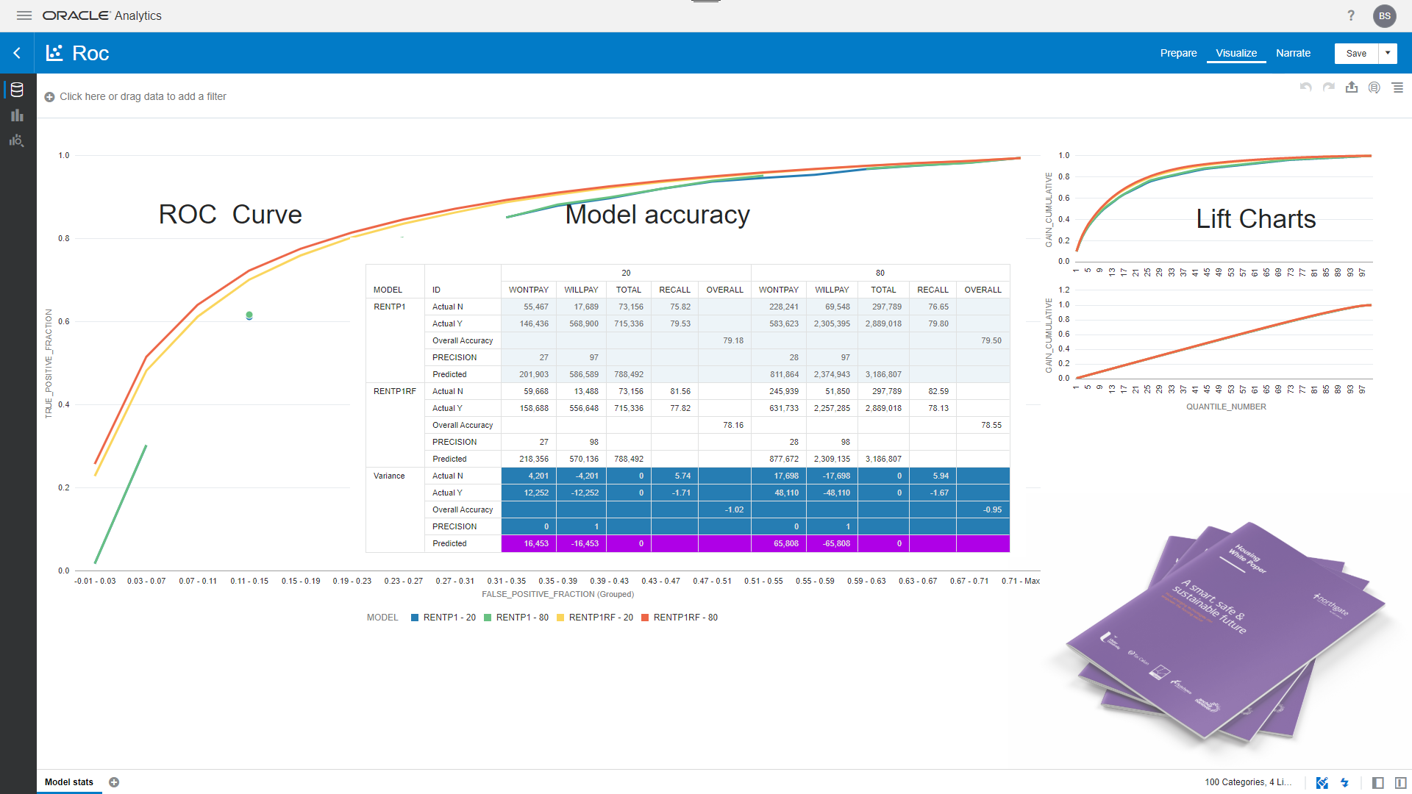

Slide 57
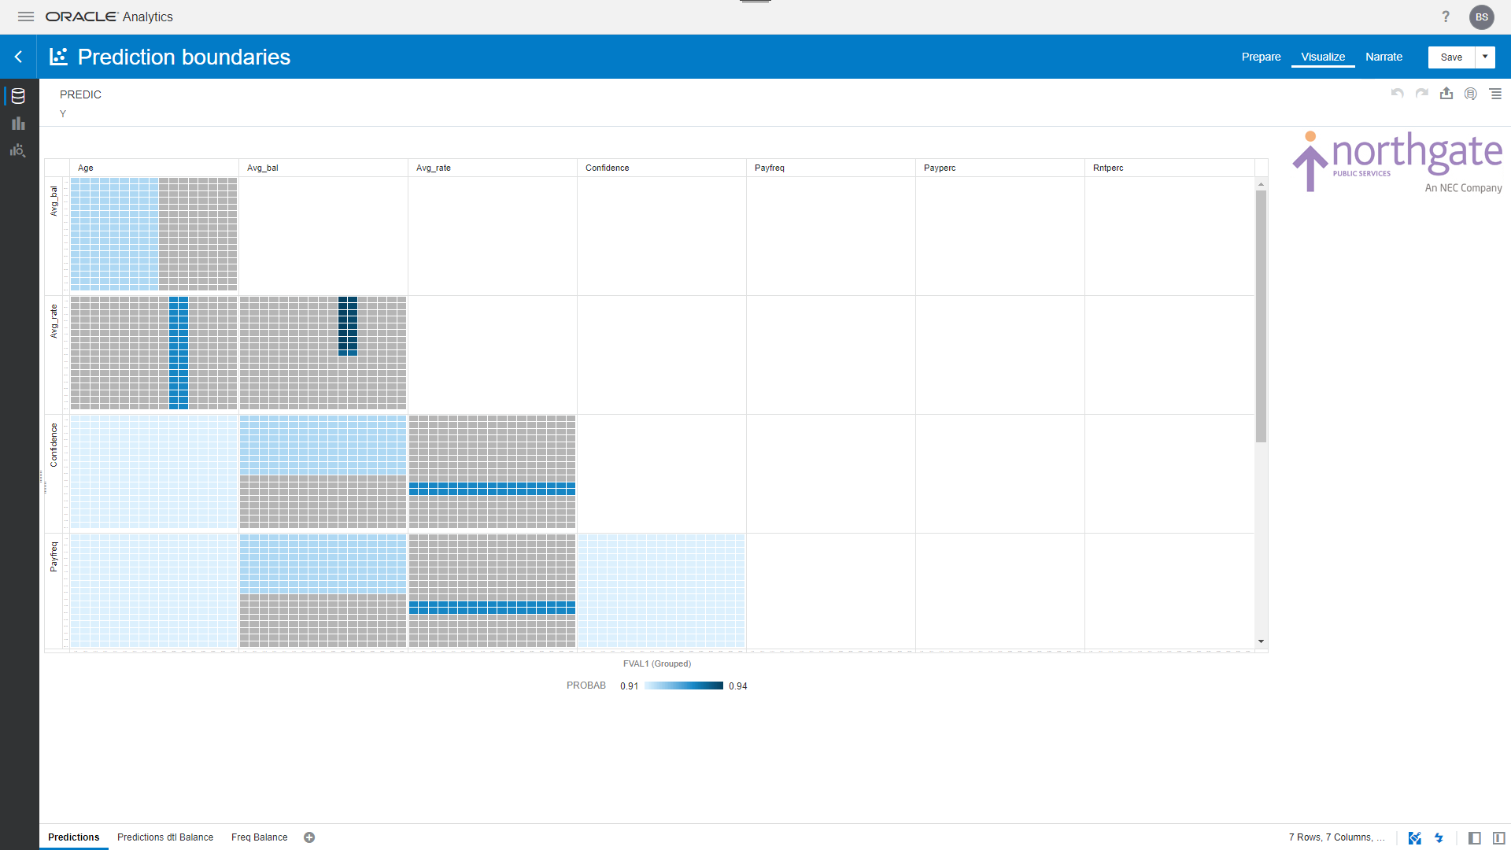

Slide 58
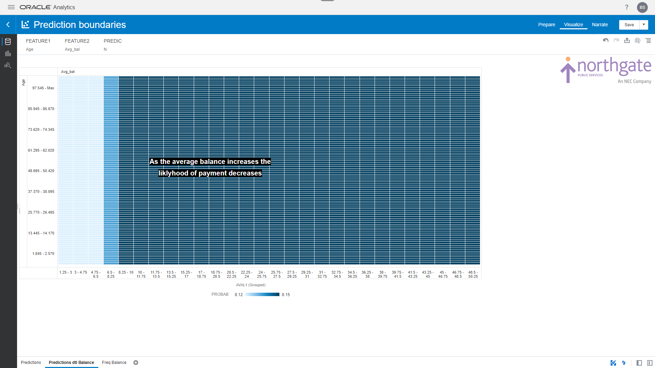

Slide 59
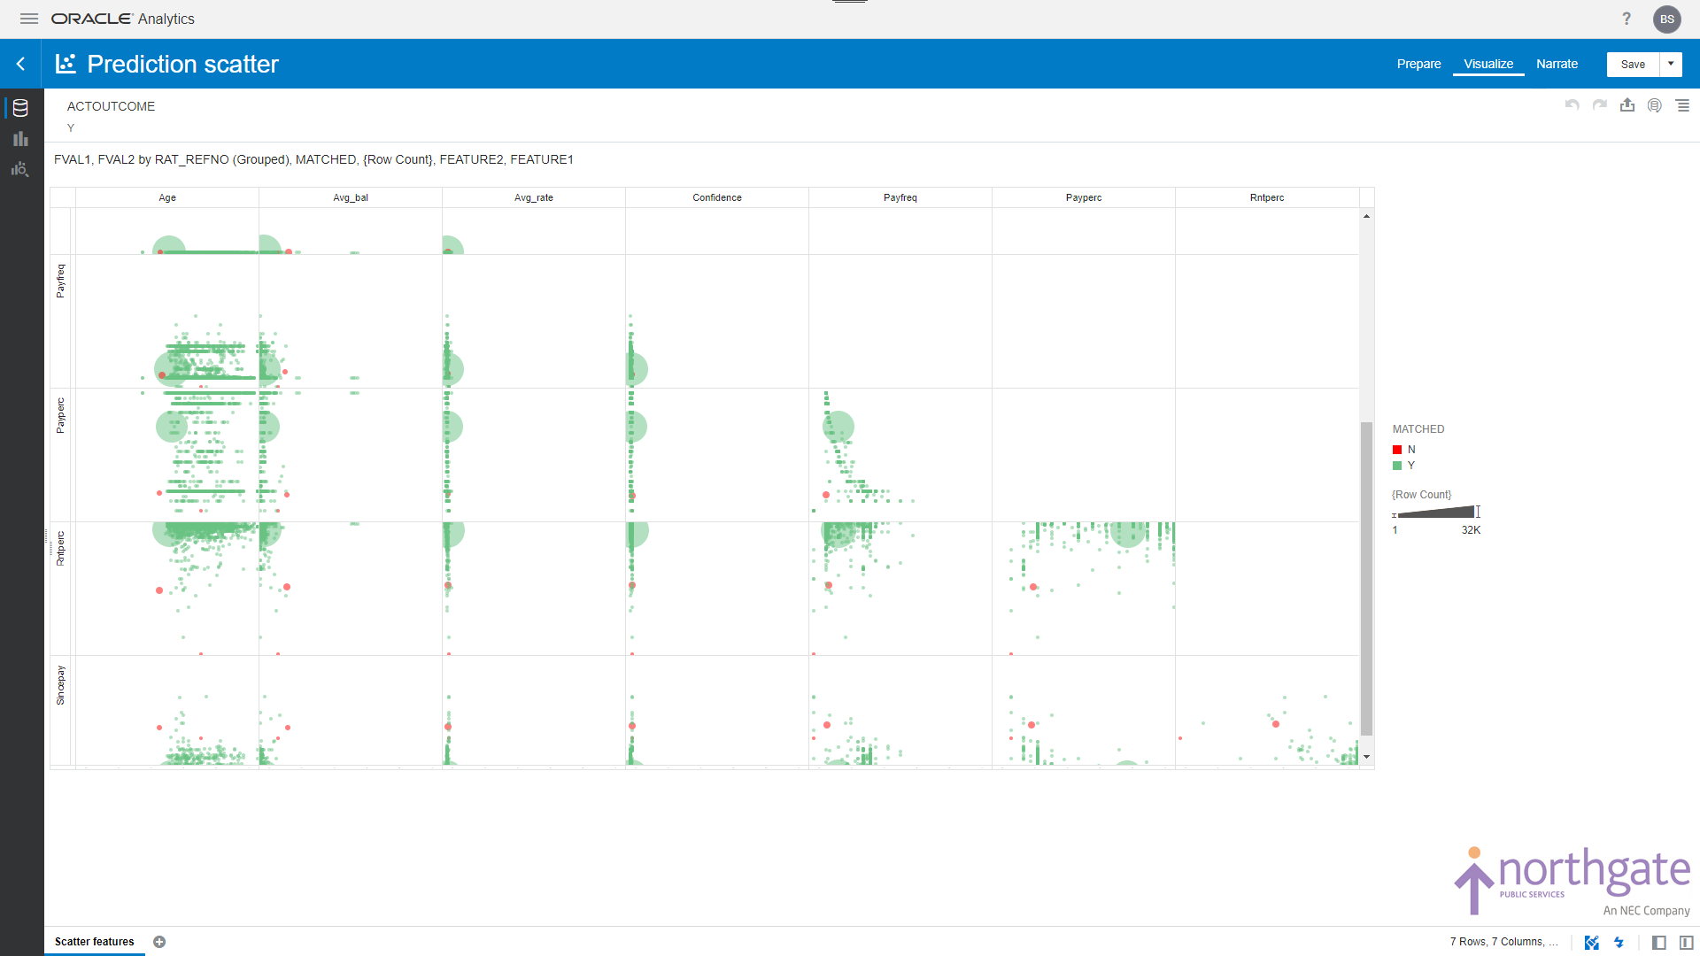

Slide 60
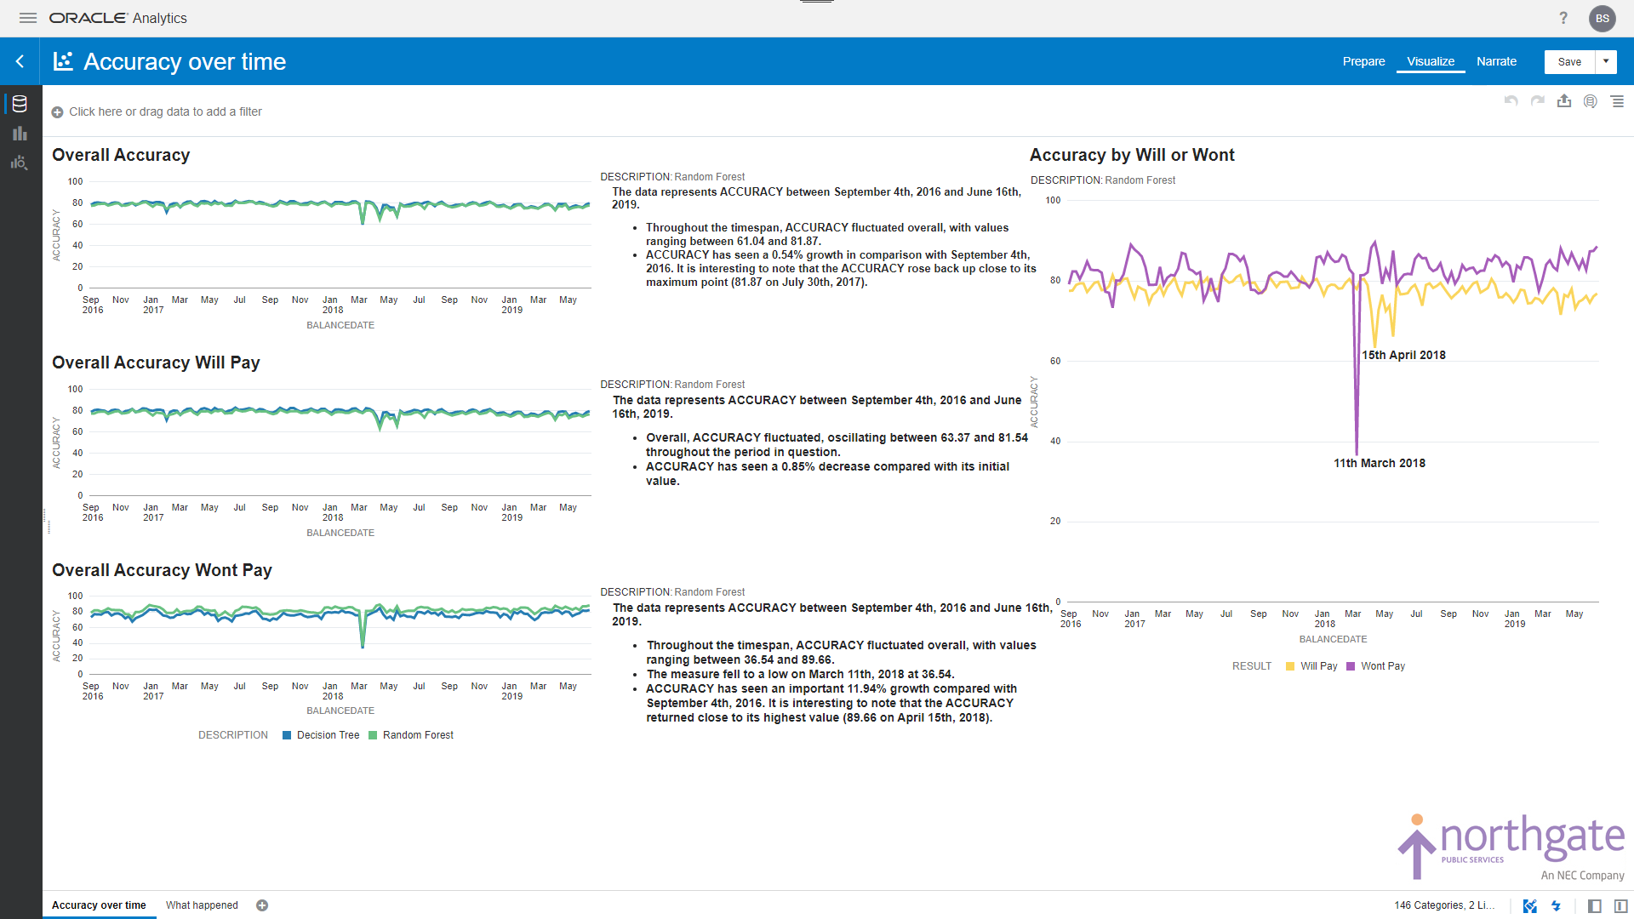

Slide 61
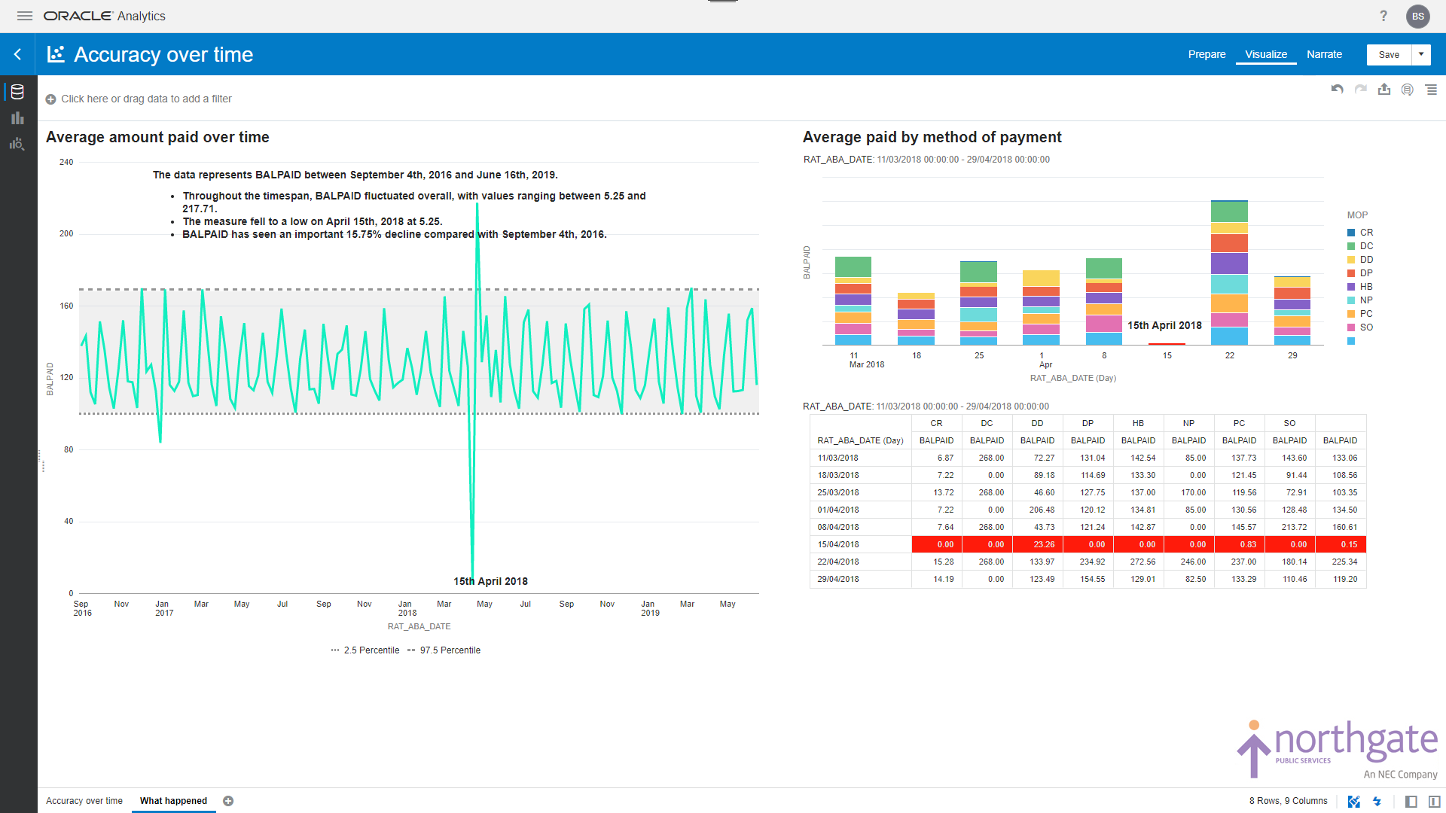

Slide 62
The End.. not quite
So, when we have an accurate working model, what do we do with it?
Well, we surface the results in our NPS Integrated Housing Management System, built on APEX 20.1
I've now shown you just the start of the modelling process and how to use Oracle ADW, ML and OAC to assist/explore the best models at a rapid pace.
By adding Machine Learning into our screens and datasets we can bring our customers the deeper insight they truly need to help their tenants in these uncertain times.

Slide 65
Thank you for watching

