Slide 1
The Data Analytics Learning Laboratory at NHSBSA
Phil Godfrey – Data Scientist
NHS Business Services Authority
July 2020

Slide 2
Who are we?
We’re an Arm’s Length Body of the Department of Health and Social Care;
We deliver a range of national services to help the NHS run efficiently. We are experts at managing healthcare information at scale and have a reputation for driving cost savings and efficiencies;
We manage £36 billion of NHS spend annually - that’s over 25% of the NHS annual budget;
Our purpose is to be a catalyst for better health. We use our data and insight to add value to the wider healthcare system;

Slide 3
The challenge
NHSBSA asked to collaborate to deliver £1bn of annual recurring savings by March 2018.
Finding and sizing the opportunities to make savings.
The answer
Driving insight from the data we hold in operational systems.
Technology that would enable us put all our data into one environment and analyse it without impacting operations.
Technology that would not turn off the lights if we asked a question of large volumes of data.
A team of people who could look after the data, do the hard sums and then present the findings.
Notes:
Given the value of the transactions flowing through our organisation,
Back in 2014, we were asked to help deliver £1billion of annual recurring savings by March 2018 to help address the funding gap.
We knew that we could do more with the data that we collect.
But as this data was all tied up in legacy operational systems, which were end of life and at capacity
The ask of technology was to provide
a technical solution that would allow us to mine the data without upsetting the business operations.
And a dedicated environment where we could put all our data and mine it without the need to create a huge structured data warehouse.
We wanted to be able to get insights quickly – because we were granted an initial period to prove the value of investing in doing data analytics on an on-going basis

Slide 4
The outcome
Creation of the pioneering data lab.
A dedicated team of data scientists and statisticians.
Over £1.6bn of potential savings identified within first 5 years.
Over 400 projects completed.
A strengthened team and new junior roles to allow career progression.
Award winning.
Notes:
In the pilot stage we identified potential savings of £100 million and met our evaluation criteria. As such the lab was given the go ahead, with a small team of DS and stats
And in the first 5 years, data analytics has supported questions and hypotheses to the tune of £848 million.
We’ve completed just under 300 projects and recently added junior career development roles
1, SDS, 2 DS, 2JDS, 1 Stat, 2 Ass Stat

Slide 5
In the beginning - Technology
Oracle Exadata and Advanced Analytics
Able to hold large amounts of data in an Oracle database.
Speed to deploy.
Secure.
Engineered in-memory system (powerful data mining algorithms executed within database).
Integration with R.
Existing Oracle database experience within the organisation.
Courses and support available.
Intuitive to use/no need for specialist skills.
Notes:
So we purchased Oracle Exadata and Advanced Analytics
Oracle Exadata is the main data storage component of the data lab. It is capable of holding large volumes of data and is incredibly fast.
The data can be stored in one place, with one set of security principles.
Once the data is loaded the Analytics component allows us to perform analysis on large volumes of data, fast. It includes a range of machine learning algorithms and basic stats function
It can also be integrated with Enterprise R which means the data can stay on the database if we wish to undertake a wider set of analytics, such as forecasting for example
The tool is fairly intuitive and easy to use.
We also had a range of courses and support available to us.

Slide 6
Where we are now - Technology
In May 2020 we moved away from On-Premise to the Cloud.
Key Benefits
Additional Storage - needed to on-board data.
Additional memory and CPU - which will aid advanced analytics work using Oracle Machine Learning.
Flexible Cloud scaling - allows the DALL to utilise the flexible cloud model where databases and services can be shut down or scaled back in order to reduce running costs or allow that Universal Credit to be used elsewhere, for example giving more resource to heavy hitting processes making the DALL more productive and efficient.
Notes:
Additional Storage - needed to on-board data.
Additional memory and CPU - which will aid advanced analytics work.
Offloading data - Allows the DALL to utilise new Oracle Cloud Infrastructure (OCI) services and functions such as offloading data sets into cheaper Object Storage and even cheaper archive storage.
Flexible Cloud scaling - allows the DALL to utilise the flexible cloud model where databases and services can be shut down or scaled back in order to reduce running costs or allow that Universal Credit to be used elsewhere

Slide 7
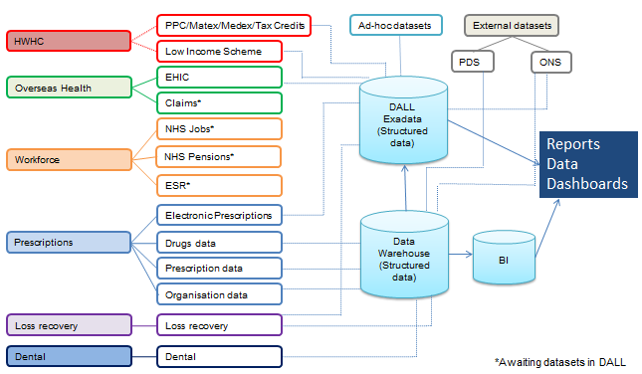
Technical Landscape
Notes:
The DALL is a sandpit development environment.
Recently moved X7 Cloud
The chart here shows our service areas and their databases which were initially loaded into our lab. We have also since added data from external data sources.

Slide 8
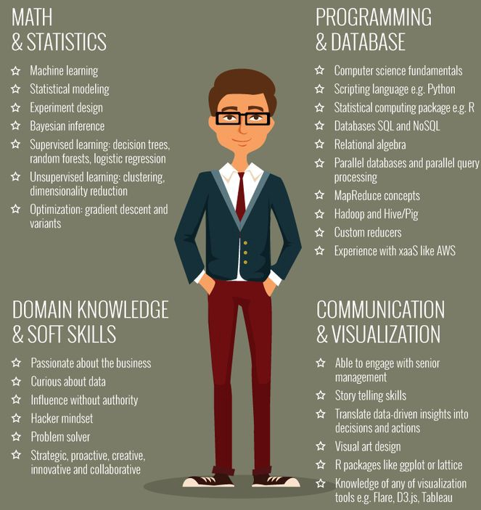
Our Data Lab
A dedicated environment for mining data.
Oracle Machine Learning.
Range of datasets which we can join together.
A dedicated team of data scientists and statisticians.
Aim to be at the forefront of delivering new insights from data that improve patient and customer outcomes and reduce loss in the system.
Notes:
Lab created 6 years ago
Provides a dedicated environment in which we can mine transactional data without upsetting business operations.
Oracle Exadata is the main data storage component of the data lab. It is capable of holding large volumes of data .
The data can be stored in one place, with one set of security principles.
And it is entirely separate to our transactional systems
We use the Analytics component and R to perform a wide range of analytic s
We have a team of Data Scientists and Statisticians including development roles
Team 3 DS,2JDS, 1AS n Newcastle, 1 S in Eastbourne

Slide 9
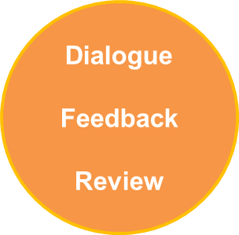
How we work
I have a problem or opportunity
The DALL operating model must be flexible to respond to the needs of our customers.
Anyone from the NHSBSA or the wider NHS can contact us for help.
All requests are assessed and logged within a tracker.
Each project has a business sponsor.
We use an industry standard methodology (CRISP-DM) for managing our data mining projects.
Business Issues
Data
Analytics
Insights
Actions
Outcomes
CUSTOMER
DALL
Notes:
The DALL has placed the business at the heart of the work it conducts.
To enable this process the DALL is utilising the industry standard methodology known as CRISP-DM.
In this process we have a problem definition which we complete with out customers .
This clearly defines the problem and the expected outcomes.
From the problem definition we complete the necessary analytics which are peer reviewed.
We then produce an insight report/ or a tool before presenting back to the customer to enable action and ultimately deliver outcomes to the business and wider NHS.
CRISP-DM, which stands for Cross-Industry Standard Process for Data Mining, is an industry-proven way to guide your data mining efforts

Slide 10
Projects and customers
Insight
Operational Improvements
Identifying loss in the system
Driving up data quality
Improving patient care
Our structure
Communications
Engagement
Data governance
What have we used it for?
Lessons we have learned
Notes:
So that’s set the scene.
Now it’s time to show you the type of work that the Data Lab has been able to do over the last 5 years and where Analytics can add value.
The Data Lab has been used in a variety of ways from improving patient care, to reducing unit costs to identifying cases of loss within the system.
We primarily undertake work for the NHS but have also worked with other public sector agencies.
We’ve learnt a lot along the way also, from information security and governance, through to having to engage with the wider business not only to generate ideas but to take our results and deliver them into action.
I am going to share with you a few projects in further detail.

Slide 11
Case Study projects
Case Study 1 – The Electronic prescription service
Case Study 2 – Dependency forming drugs
Case Study 3 – Understanding how our customers use ePACT2
Case Study 4 – Asthma Prescribing

Slide 12
The Electronic Prescription Service (EPS)
EPS makes it possible for prescriptions to be sent electronically from GP practices to a dispenser (such as a pharmacy) of the patient's choice.
EPS was introduced in 2009 and is currently optional so prescriptions do not have to be prescribed electronically. Eventually EPS will remove the need for most paper prescriptions.
The NHSBSA had a target electronic prescribing rate of 72% by March 2019 in order to realise operational savings. Benefits of EPS include:
Saves the costs and reduces the environmental impact associated with creating, processing and storing paper.
Benefits for GP practices, pharmacies and patients through efficiencies, convenience, safety, security and accuracy.
Provide us with additional insights which can help to improve patient care.
Notes:
Turning now to the electronic prescribing world which is one of the areas in which we have conducted a great deal of analysis.
Electronic prescribing allows prescriptions to be sent electronically from a GP to a pharmacy for dispensing to the patient.
And then from the pharmacy to us for payment.
As the prescription information is sent electronically rather than via paper forms, you may imagine that it offers a range of benefits
for GP practices, pharmacies, patients and the NHSBSA
It’s more convenient, accurate, secure and efficient.
At the NHS BSA we have a target to achieve of 72% electronic prescribing by March 2019 to help us realise operational efficiencies.
We were asked to forecast the electronic prescribing rate at the end of 2016.

Slide 13
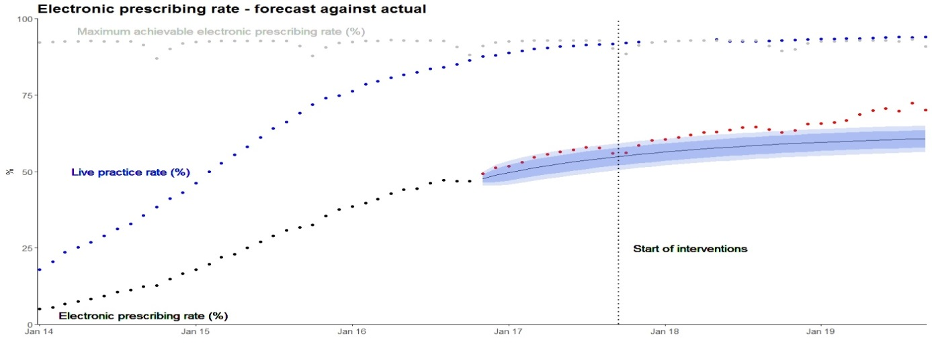
The Electronic Prescription Service (EPS)
We used the ARIMA forecasting technique to predict the take up of electronic prescribing. The number of GP practices which were enabled to prescribe electronically was used as a regressor.
Analysis was based on:
3 years of prescription data
Over 3 billion rows of data
Over 47 million patients
8 different data sets
Over 7 thousand GP practices
Notes:
On this slide you can see the forecast that we produced based on things continuing in the same vein.
We were able to use 3 years worth of prescription data which involved over 3 billion prescription items
The best fitting model was an ARIMA model with a regressor of the number of GP practices which were enabled to prescribe electronically.
So you can see here the forecast which is the black line from November 16 and confidence interval shaded in purple.
The blue dotted line shows the % of GP practices enabled to prescribe electronically.
We were happy that the forecast was reasonable but the target was 72% and we were forecasting a rate of around 60% by March 2019
We undertook some additional modelling to understand how we might improve the rate.
The red points show the actuals and you can perhaps see that we are starting to see a departure from the forecast over the last 6 months,
And we believe that this is following some intervention work we have been undertaking.
67.4% as at December 2018

Slide 14
The Electronic Prescription Service (EPS)
Data is key to helping us achieve our goal!
What if modelling – We have modelled a range of scenarios to understand their impact on electronic prescribing.
Benchmarking data - We are starting to provide electronic prescribing data and enhanced reporting for GP practices, pharmacies and CCGs.
Enhanced reporting - We are working with GP practices to identify patients who may be suitable for electronic repeat dispensing.
Supporting CCGs, practices and pharmacies - through training, signposting and support tools designed to engage patients and generate demand.
Notes:
We identified that efforts were needed to focus on increasing the rate in live GP practices
And our analysis has informed a range of actions including
Providing electronic prescribing data and reporting for GP practices, pharmacies and CCGs.
Helping practices to identify patients who may be suitable to move across to electronic repeat dispensing regimes.
Providing support and training on the ground
We believe that these actions are starting to take effect and we have a year to increase the rate by 10 pct points
67.4% as at December 2018
The average practice has increased its EPS Utilisation by 9% since September 2017

Slide 15
Real-time Electronic Prescribing
Current timeline for processing Paper prescriptions is around 6-8 weeks from prescribing to be available for reporting/analysis.
Electronic prescriptions do not require scanning or additional processing, reducing the turnaround time to within 1 week from prescribing and 1-2 days from claimed by the dispenser.
What can we do with this information?
Enables our users to observe and mitigate any impact on prescribing and dispensing across England, such as behaviour changes / shortages / surpluses / stockpiling, nationally and at prescribing practice level.
Identify patients suitable for electronic repeat dispensing to relieve pressure on GPs and reduce footfall in surgeries.
Supports various reporting requirements including Brexit and COVID-19.

Slide 16
Dependency Forming Drugs
Drug abuse isn't just about recreational drugs. Besides marijuana, legal medicines are the most commonly abused drugs in the UK. Some prescribed drugs can be addictive and dangerous.
One patient in eleven (8.9%) who receives a prescription is prescribed one of these medicines.
Antidepressant prescriptions in England have more than doubled in the past 10 years.
A recent survey also found that 7.6% of adults had taken a prescription-only painkiller not prescribed to them.
From April 2017 to March 2018 there were approximately 149 million dependency forming drug items dispensed at a cost of £1.2bn.
Notes:
An area of growing concern is the continual increase in the prescribing of addictive or dependency forming medication.
These include, Opioid medication, anti-depressants and benzodiazepines.
One in eleven patients who receive a prescription, is prescribed ones of these medicines
From April 2017 to March 2018 there were approximately 149 million dependency forming drug items dispensed at a cost of £1.2 billion.
We are currently working with PHE to provide data to assess the scale of the problem,
the harms caused by dependence and withdrawal, how they may be prevented and the best way to respond

Slide 17
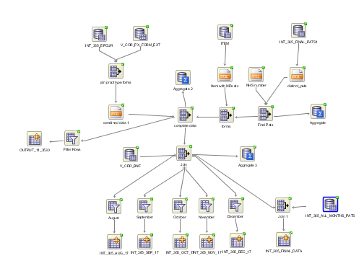
Dependency Forming Drugs
Purpose
To investigate the number of Prescribing Practices and Pharmacies that a single patient visits over a 6 month period and if this could indicate the misuse of drugs by a patient or prescriber.
Why?
This may uncover potential loss within the system.
How?
Identify prescribing of drugs with known addictive or misuse properties and investigate any unusual quantities or prescribing patterns.
Notes:
Distinct NHS numbers were used to identify patient which fell into 4 groups.
Group 1 - one prescribing practice one Pharmacy 91%
Group 2 – one prescribing practice multiple Pharmacies 6%
Group 3 – Multiple prescribing practices one pharmacy
Group 4 – Multiple prescribing practices and multiple pharmacies 0.9%
For opioid drugs any value over 1,680 would be considered unusual (this represents 7 months’ worth of 30 day prescribing of the maximum recommended dose of 8 per day, to allow for 1 months grace where a prescription may have been submitted for late for reimbursement ).

Slide 18
Dependency Forming Drugs
Findings
Small number of patients received twice maximum dose of painkillers over a six month period.
Some examples show patients registered at two different addresses, at two different GP practices, in two different CCG areas.
As well as combinations of pre-paid / exempt prescriptions across practices.
Notes:
The details of this case study will be shared with NHS England Fraud team on Wednesday 9th May. Following this meeting further work may be carried out.

Slide 19
Dependency Forming Drugs
Findings
2,000 patients (66,000 items) where patients had visited multiple prescribing practices and Pharmacies every month for 6 months, for drugs with known misuse or addictive properties.
11 cases of potential loss in the system have been highlighted.
Next Steps
The findings have been escalated to the NHSBSA and NHS England Fraud teams for further investigation.
Notes:
Due to the quantity of data and the manual time required to review the individual prescriptions to identify possible fraud or error this analysis has been limited to the patients that were in either the top 20 drugs by quantity or the top 20 drugs by the number of prescribers visited in the six month period. Several NHS numbers appeared in both lists.

Slide 20
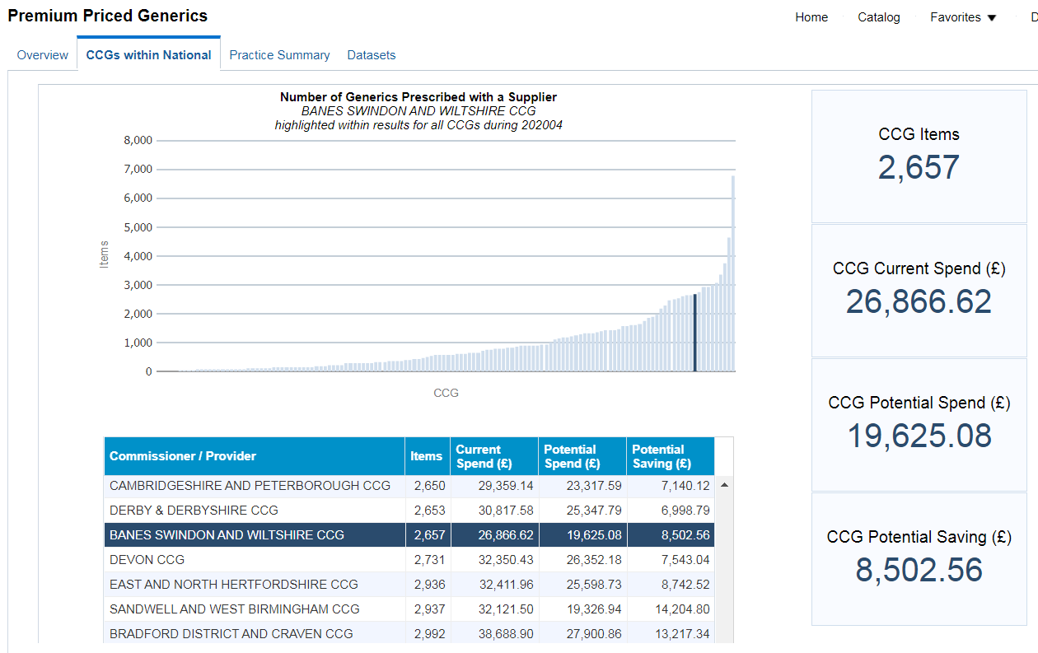
Understanding how our customers use ePACT2
The business challenge
Our Oracle BI tool, (ePACT2) was launched in June 2017 and has over 4,000 users.
We wanted to understand more about how our customers use dashboards and create custom analyses in order to improve:
user experience
query performance
As of January 2019, usage tracking tables have been recording a range of data regarding transactions.
Notes:
Text mining and tokenisation were required to transform this into a more manageable form. This allowed the generation of features that accounted for and explained user behaviour.

Slide 21
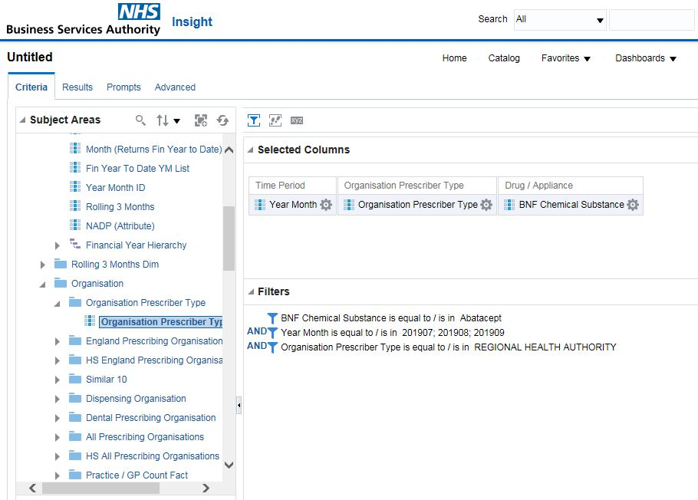
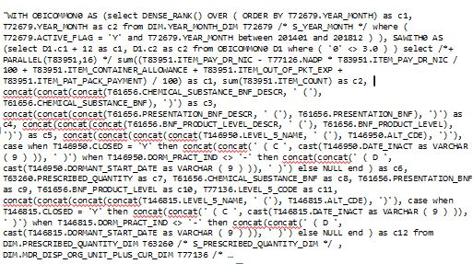
Understanding how our customers use ePACT2
The technical challenge
User behaviour is stored as hard to decipher SQL-like code.
The logical (front-end) and physical (back-end) SQL is stored in different formats.
The longest queries were several hundred thousand characters long.
Notes:
Logical SQL – what the user is doing
Physical SQL – what the DW is doing
The logical front-end SQL and physical back-end SQL contained information for both dashboard interactions and custom analyses,
The logical and physical SQL queries were stored in separate tables.
They both needed separately analysing, then joining up to link one to the other
Each of these 2 tables were then tokenised for dashboards and analyses separately.
Runtime was contained within the table containing the physical back-end queries.
The frequency of use was generated by determining how often each field/column appeared in query separately, and then for all queries in total.

Slide 22
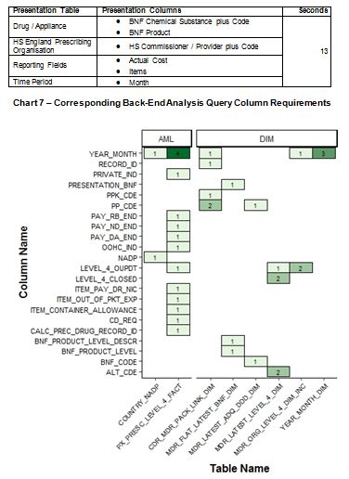
Understanding how our customers use ePACT2
Analytics
Using text mining, regex pattern matching and tokenisation, the front-end fields selected by the user, and the corresponding back-end columns, were extracted. This transformed the data into a more manageable form.
This meant we could determine how users were using ePACT2, and how their front-end behaviour translated into back-end Data Warehouse requirements.
Query analysis was later stored as Document Term Matrices, (DTMs), ready to be used in machine learning models to predict runtime.
Notes:
DTM: The ‘document’ is the chunk of text analysed. Around a 1000 back-end columns were used (closer to 900 actually in fact).
DTMs are also ‘sparse matrices’. They are ‘sparse’ due to there being so many zeros. Eg, if a query used only 2 columns, and if the sparse matrix had 1000 columns, then 998 would be zero, and only 2 would have a value in, hence sparse matrix. Sparse matrices can be compressed due to the vast amounts of ‘empty’ space within them.

Slide 23
Understanding how our customers use ePACT2
Outcomes
Analysis allowed us to understand usage of dashboard pages, reporting fields and back-end columns, in addition to runtime. This is being supplemented with user research and engagement.
Analysis is informing discussions around streamlining fields and subpages and improving dashboard design to improve both performance and user experience.
Next Steps
To productionise the logical and physical SQL query tokenisation, meaning the output can be utilised and leveraged by all staff.
To undertake additional work with the DTM output, to generate further insights into runtime and to understand behaviour in relation to user types.
Notes:
The DTM storage bit is an interesting point.
In essence, it means that an SQL query that is several thousand characters long can be stored as a single row, where the vast majority of the values are null or empty, meaning it can be compressed efficiently

Slide 24
Data + Data = Insights?
Could the assemblage of pollution, pollen and climate data, in conjunction with our own prescription data, be leveraged to provide further insights?

Slide 25
Asthma prescribing
The challenge
There are 5.4 million people currently receiving asthma medication.
Every 10 seconds someone is having a potentially life-threatening attack.
The NHS spends around £1 billion a year treating and caring for people with asthma.
If we can raise patient’s awareness of what triggers their asthma, we can save both lives and money.
The NHSBSA have embarked on a programme to understand how we can use our data to improve population health outcomes.

Slide 26
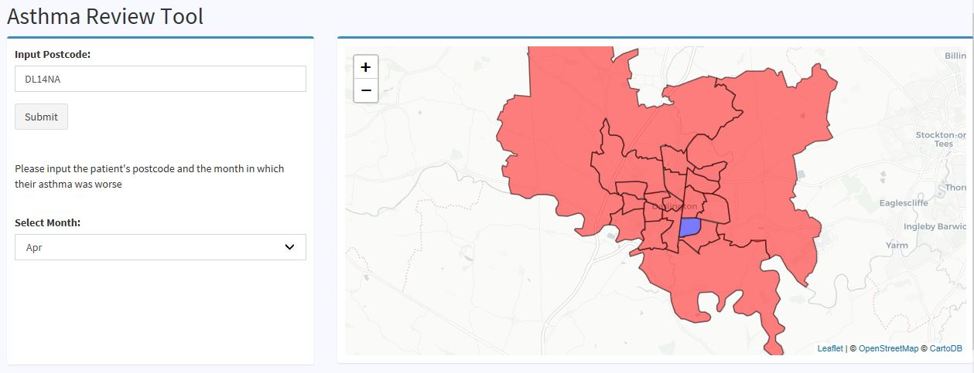
Asthma prescribing
Using our prescribing data and environmental data, we are developing a prototype application, initially focused around asthma, but could be expanded for a range of other areas of interest.
The asthma profile cross-references prescribing data against environmental factors such as pollen counts, pollution levels and climate to help provide further insights into what other triggers may influence asthma prescribing.

Slide 27
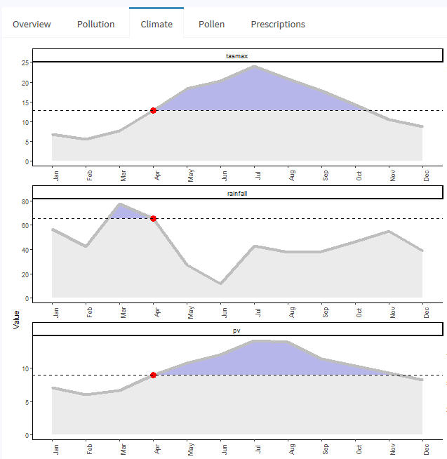
Asthma prescribing
The additional information helps to identify which particular pollution, pollen or climate related factors coincided with the worsening of a persons asthma. This will lead to prevention through clearer identification of an individuals own triggers.
By overlaying this with our short course inhaler prescription data, it is possible to determine localised prescribing trends.

Slide 28
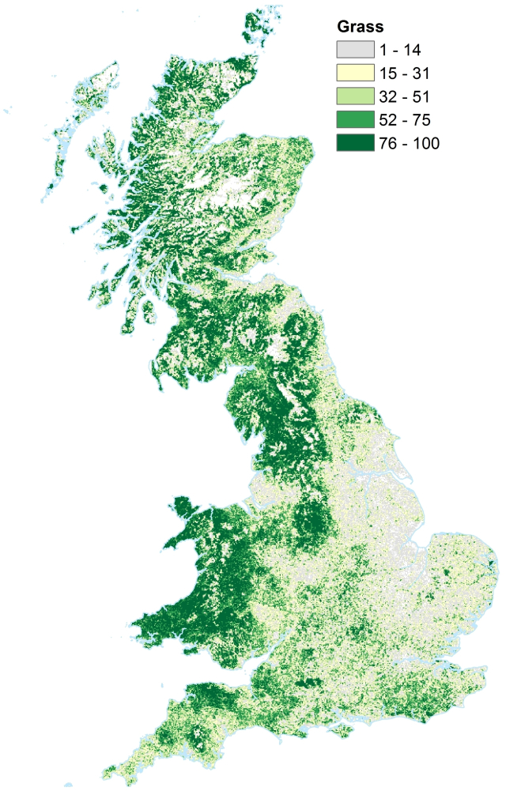
Asthma prescribing
To power this tool, we are working with 1km x 1km UK grid raster data, which is then mapped to ward and local authority level shape objects.
All 2 million plus patient postcodes are then classified on the same level.
Surface Trend Modelling used to help predict pollution from surface level phenomena, like population and road density etc.
Combining environmental data with our prescribing data offers a range of other opportunities in terms of generating insight and improving patient outcomes!

Slide 29
We also undertake analysis across a range of other services areas!
Analysis to support digitisation of services including prescription prepayment certificates and maternity exemption certificates.
Text analytics and sentiment analysis on customer feedback and survey data.
Developing and piloting an approach to detect unusual behaviour in claims made by opticians for NHS services. This was operationalized to allow for the national roll out.
Work with NHSBSA Dental Provider Assurance and NHS England to develop a methodology for estimating and reclaiming the value of inappropriately claimed Units of Dental Activity by contractors.
Identifying potential loss in the system for European Health Insurance Cards.
Notes:
Finally here are some examples of the other types of analysis we under take across our other service areas.
Supporting Digitisation – Evaluating the progress of the digitisation programs for Prescriptions prepayment certificates and maternity exemption certificates, this included looking at the uptake from certain demographics such as ages groups.
Text analytics on Customer feedback surveys– We used machine learning to train a model from the coding of responses on a survey to code the latest responses.
Ophthalmic data – Receiving a new data set to the organisations and Using R functions to sort excel data received from local teams in to a standard format and applying a risk based sampling methodology to score opticians based on activity to carry out a pilot process, with the view to role it out nationally.
Machine learning on recruitment – Forecasting the number of recruitment campaigns likely on a monthly basis for work force planning and also a prediction model of the likely number of applicants for a job based on the grade and location.
EHIC - Looking at multiple EHIC applications at the same residential address. – used to build a new end application and claim process .

Slide 30
Next Steps
Continue working with business areas to identify other opportunities to derive insight from our data, including the scoping of initiatives in new datasets.
Realise benefits of moving to the Cloud and new features now available to us.
Deployment of some our data science insights to help realise operational efficiencies.

Slide 31
Any Questions?

