Slide 1
Using OAC to manage cloud instances
Gary Crisci, Oracle ACE Director

Slide 2
Gary Crisci
gary.crisci@ge.com
GE Corporate Finance IT
Principal Architect & Application Portfolio Manager
901 Merritt 7
Norwalk, CT 06851
Twitter: @garycrisci
Blog: garycris.blogspot.com
LinkedIn: linkedin.com/in/garycris

Slide 4
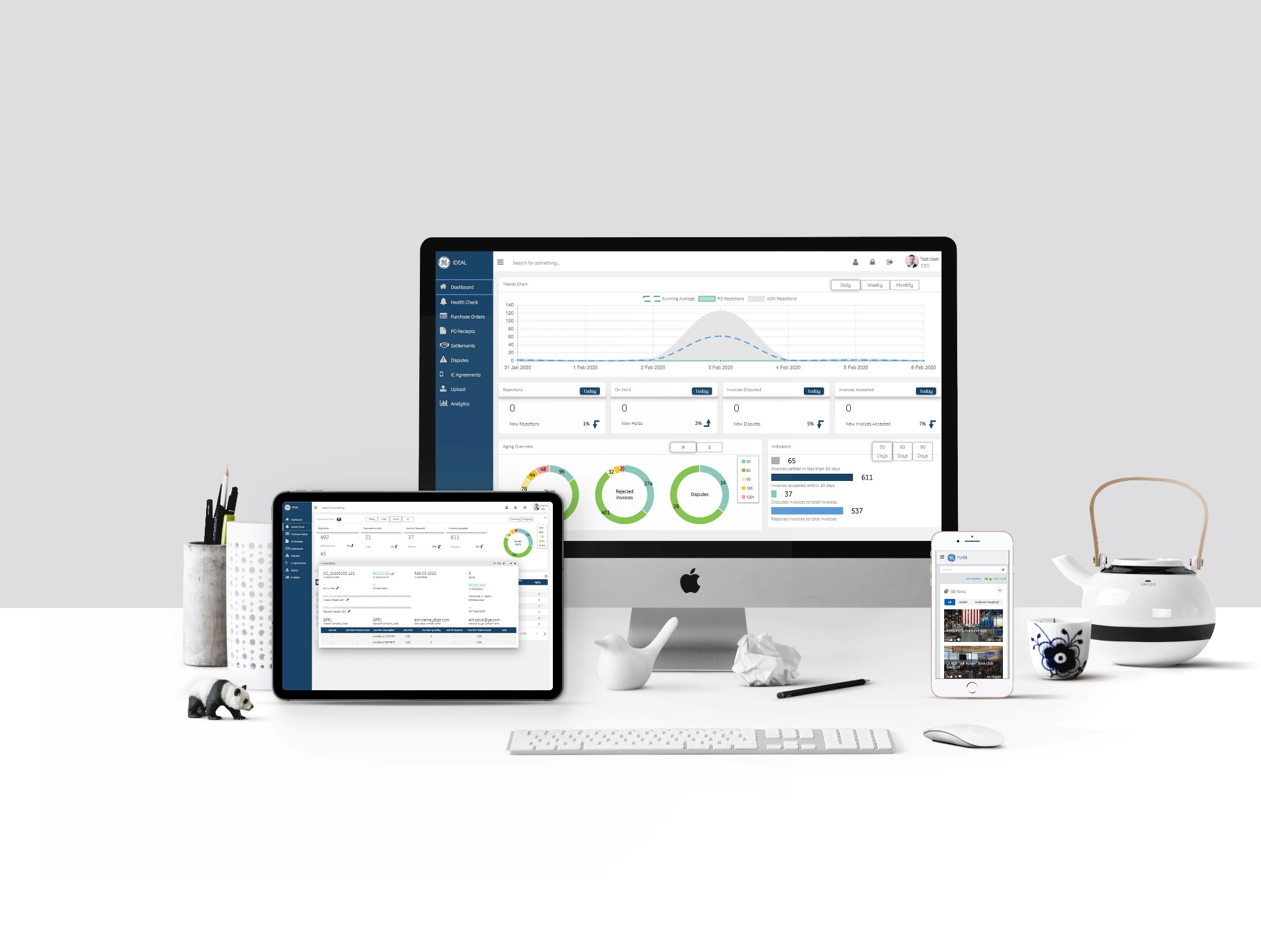
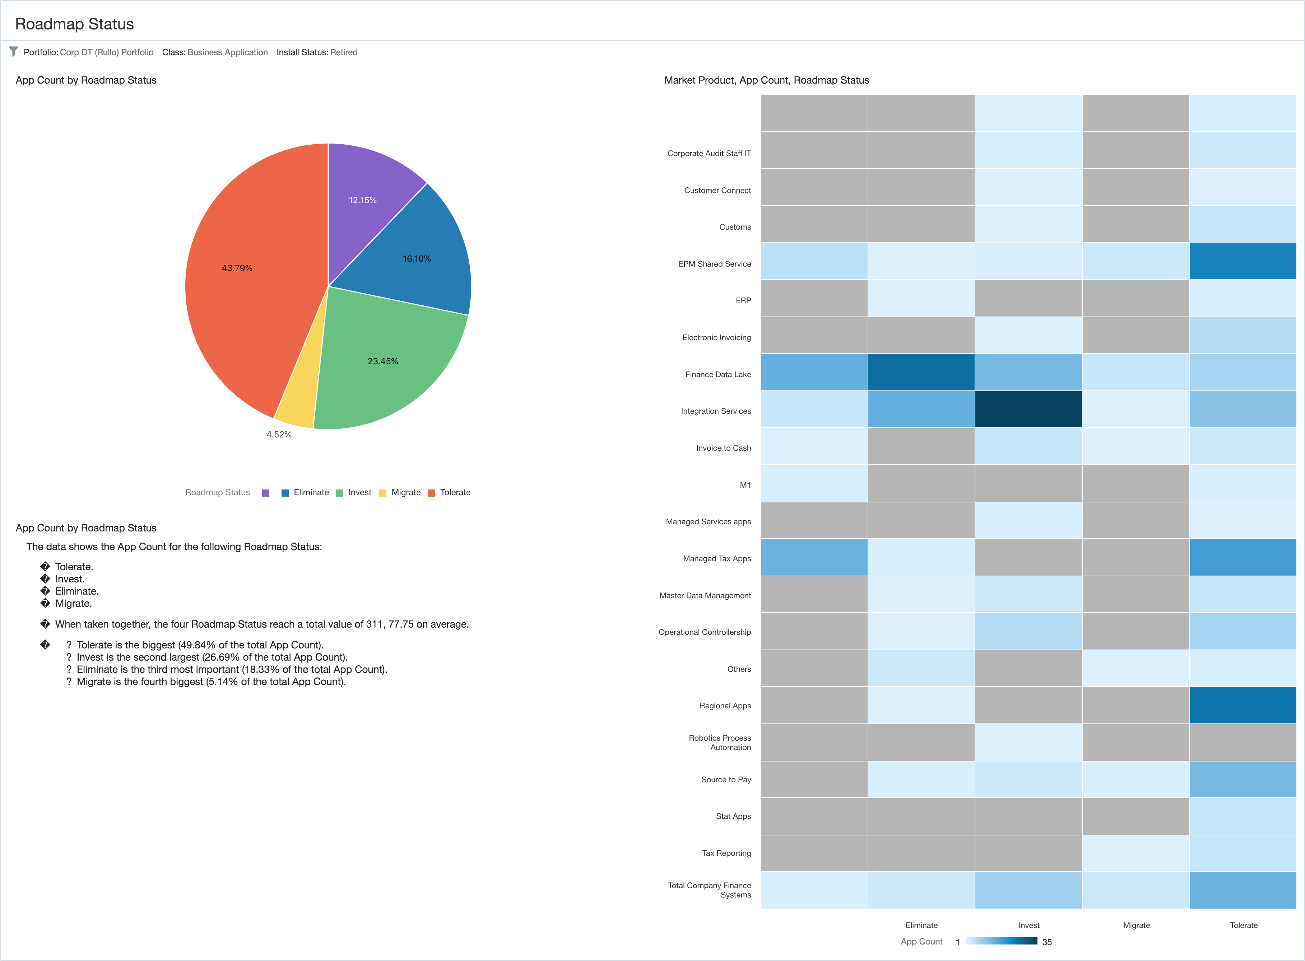
Agenda
Functional Concepts
Source system exports
Data processing with Data Flows (Live)
Create a data set
Join data sets
Select and rename fields
Create new fields
Export data set
Building visualizations to understand data (Live)
Closing and Q&A

Slide 5
Functional concepts
APM
Application portfolio management (APM) is a framework for managing enterprise IT software applications and software-based services. APM provides managers with an inventory of the company's software applications and metrics to illustrate the business benefits of each application.
CMDB
A CMDB is a repository that acts as a data warehouse – storing information about your IT environment, the components that are used to deliver IT services. The data stored in a CMDB include lists of assets (referred to as configuration items) and the relationships among them.

Slide 6
Portfolio planning
IT Planning & Portfolio Management Platforms provide decision-makers with insight into the IT portfolio to make the right IT investment decisions and to plan how IT will support the organization and its mission in the future.
Crosswalk across and analyze your IT portfolio
Govern your IT portfolio
Plan in a collaborative way
Capabilities
Application portfolio management
Technology portfolio management
Business capabilities modeling
Enterprise Architecture

Slide 7
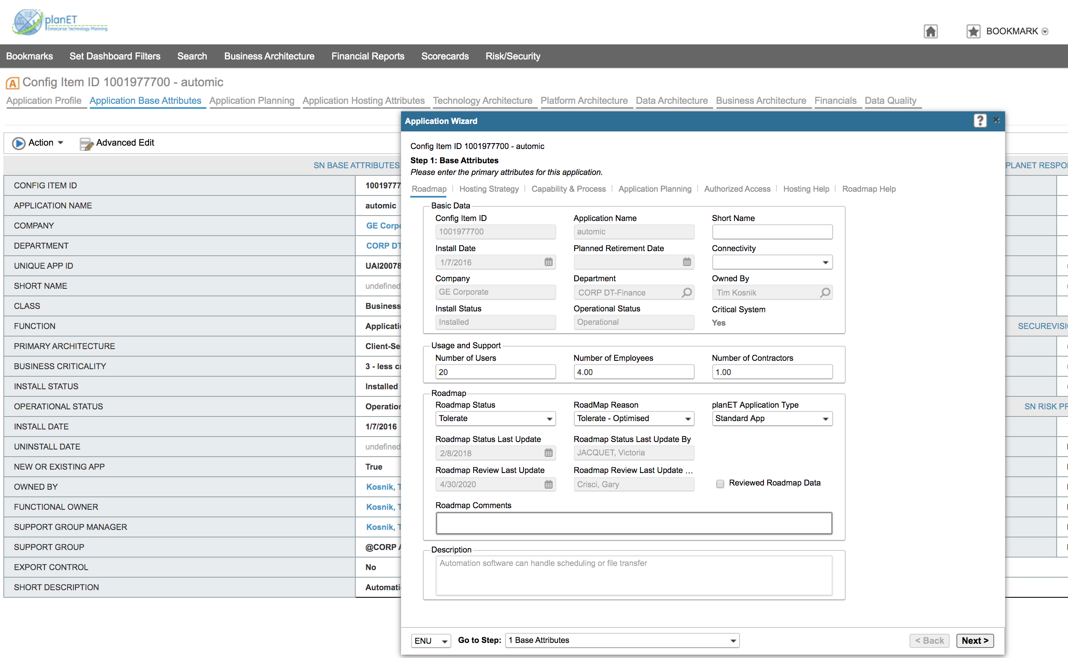
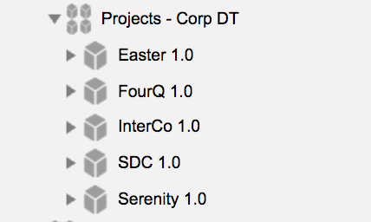
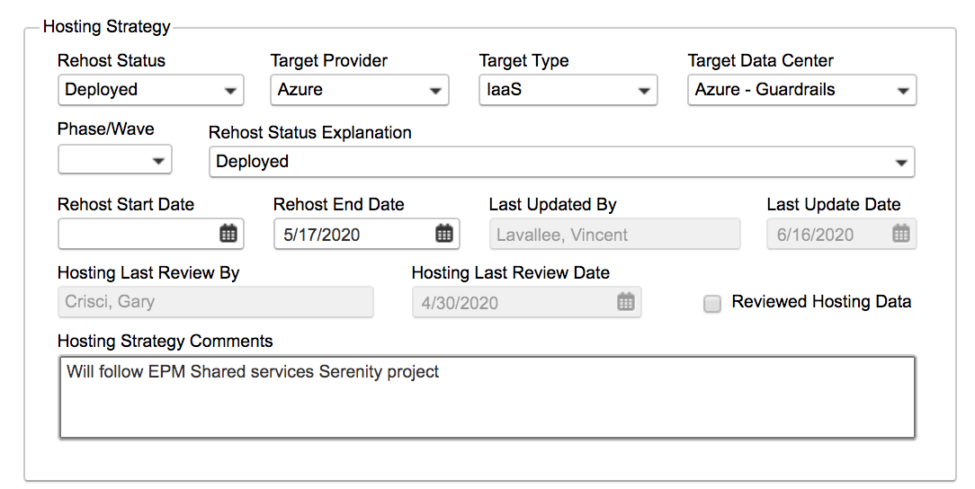
PlanET

Slide 8
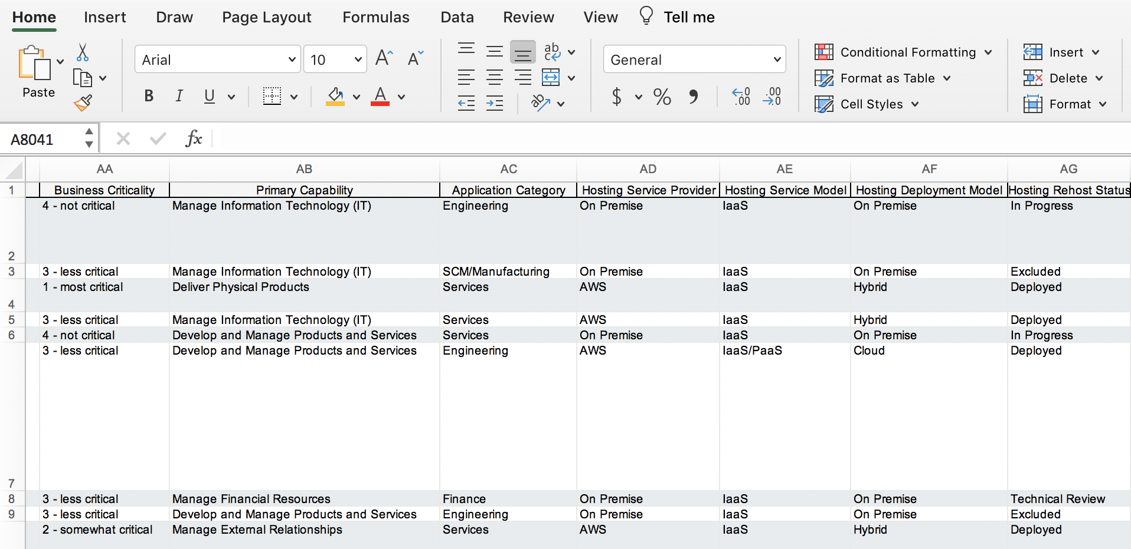
System exports

Slide 9
Oracle Analytics
Create a data set
Create a data flow
Select fields
Create Joins between data sets
Rename fields
Create calculated fields
Generate a new data set
Build reports
Create calculated fields
Add visualizations
Tiles
Bar
Pie
Heatmap
Tables
Narratives
Publish and Export

Slide 10
Q&A

